Slide 1
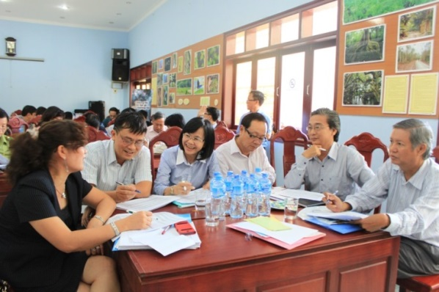
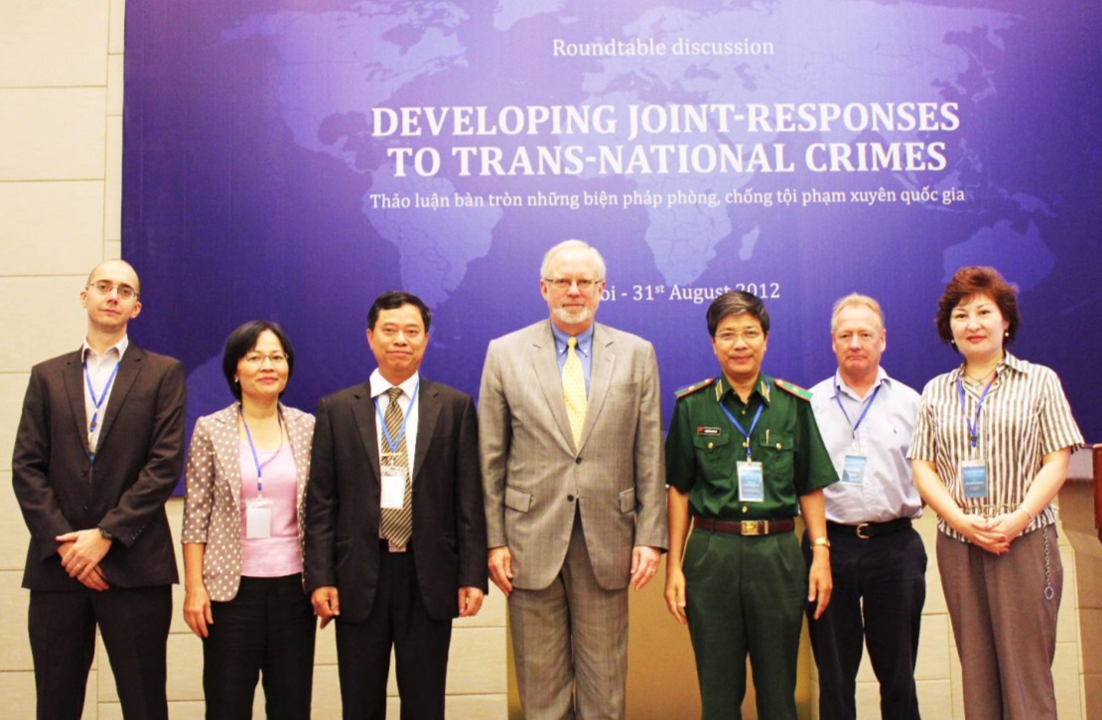
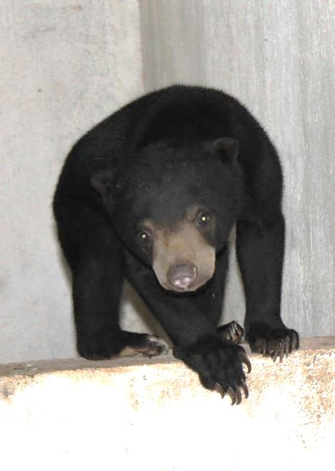
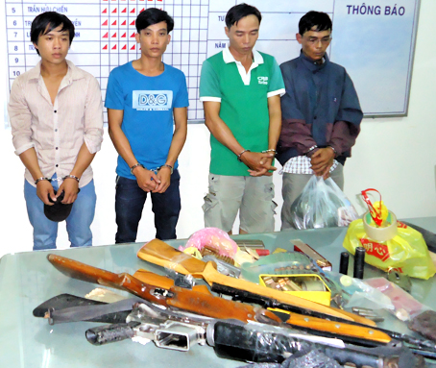
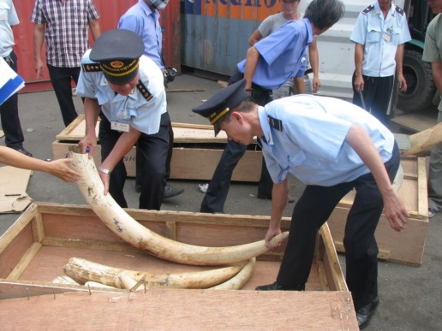
Building political support to catalyze action in Vietnam
WCS-Vietnam Program
March 2014

Slide 2
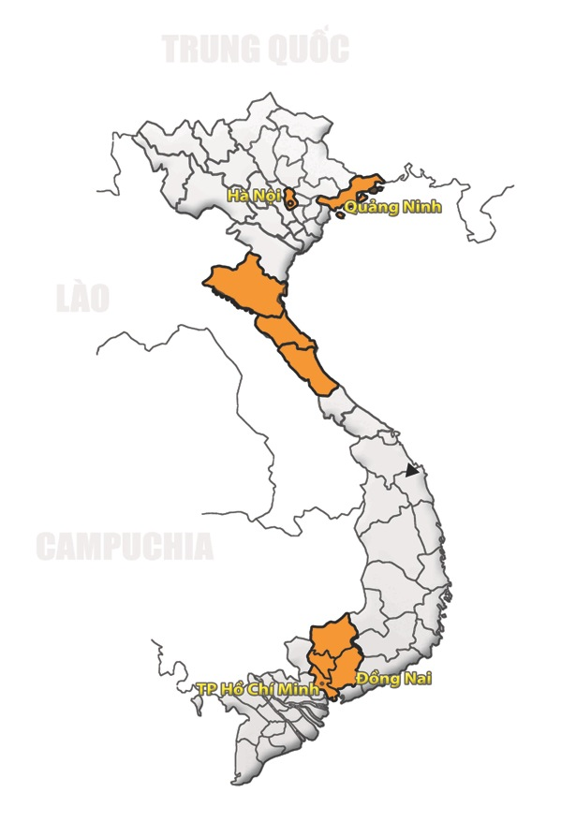
National
North
Central
South
Notes:
Vietnam program focuses on IW trafficking.
Over the years, we have tried a number of ways to build political support and leverage actions in a number of provinces. As we all know, every place has its own unique situation due to a number of factors.
Nonetheless we have identified a general model that resulted in success. Here we will go through this framework, but we will also look at the specific conditions we worked to create to achieve success.

Slide 3
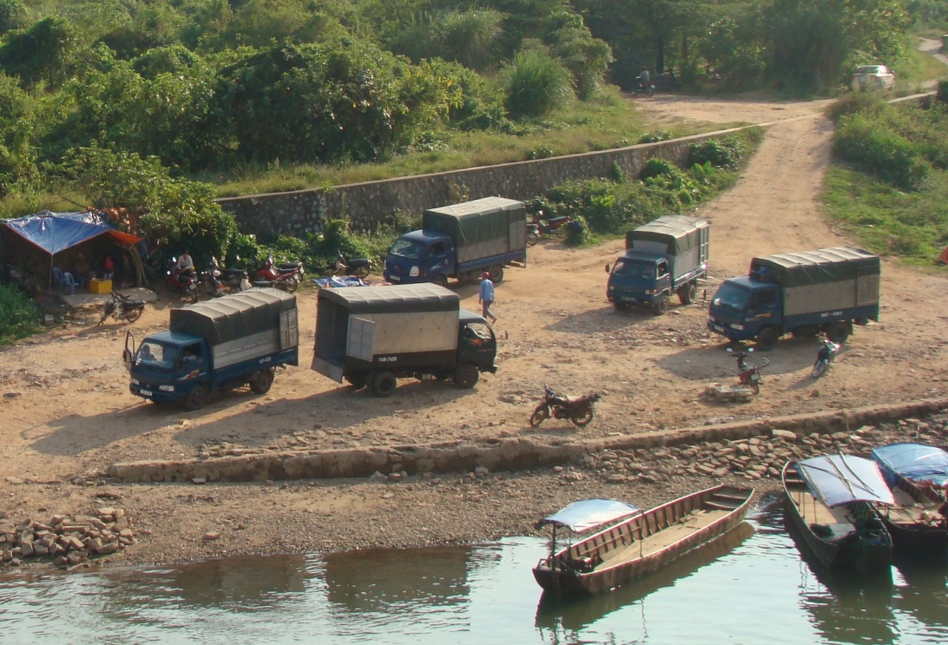
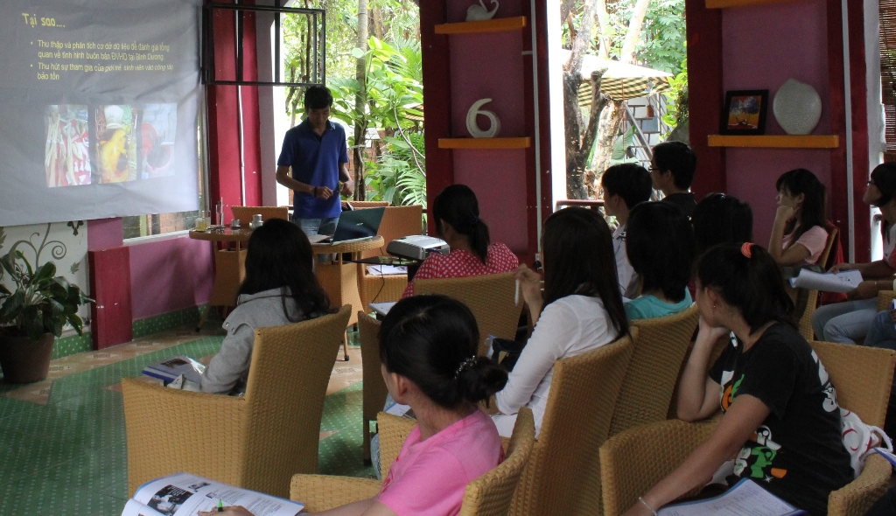
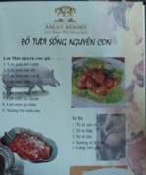
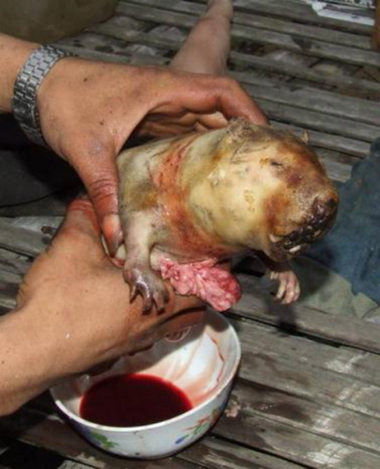
Step 1: Provide objective, quantitative, and reliable information
Quang Ninh
HCM, Dong Nai, Binh Duong
Notes:
The first step is to collect and provide intelligence that is objective, quantitative, and most importantly, reliable
Objective: Standardised research method (e.g. surveillance) → Factual information → Robust data
Quantitative: Provides a sense of scale of the cases at hand, often this is related to money → incentives
Reliable: is to ensure agencies that they will be rewarded for taking actions

Slide 4
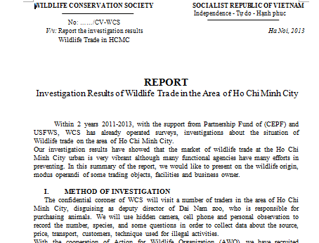
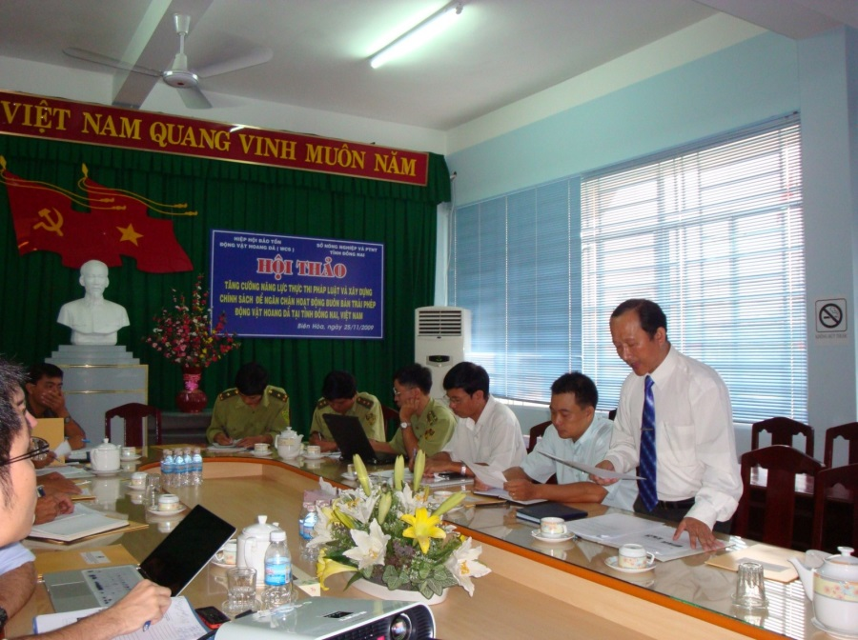
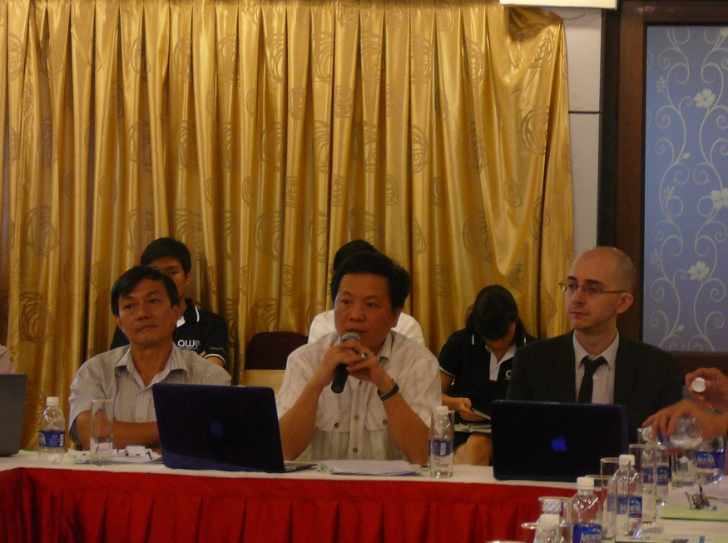
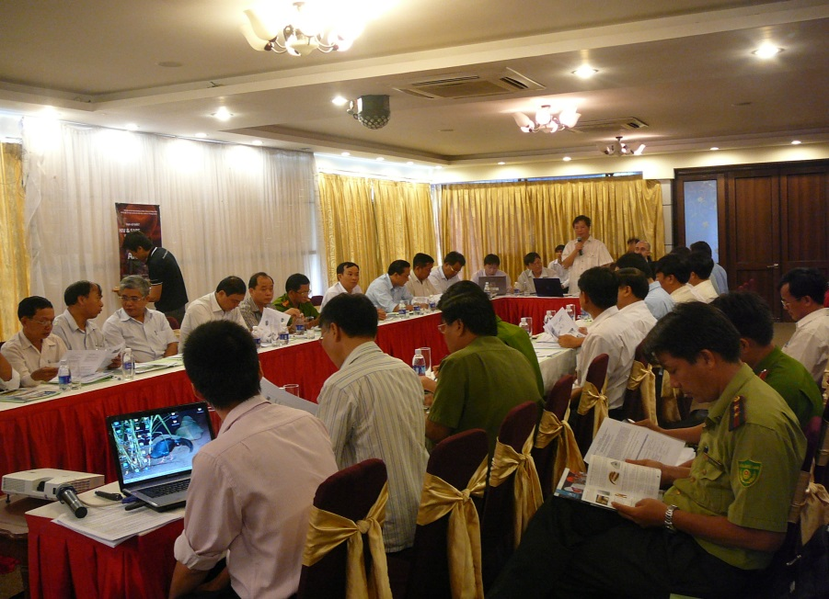
Step 2: Communication of information to relevant agencies
Notes:
The key word here is relevant, and by relevant we mean the agencies that have the authority and resources that will be able to take effective actions
Example: communicated results to the HCM EP and FPD in 1-on-1 meeting.
IN Lam Dong, we held IA meetings with district and province level agencies
IN some cases, this will also depend on identifying a non-corrupt partner
QN:
Research indicates a corrupted provincial agencies
Higher level audience:
National Assembly Committee
NACSC
VN-WEN
QN C127 – Anti smuggling
US, UK Embassies

Slide 5
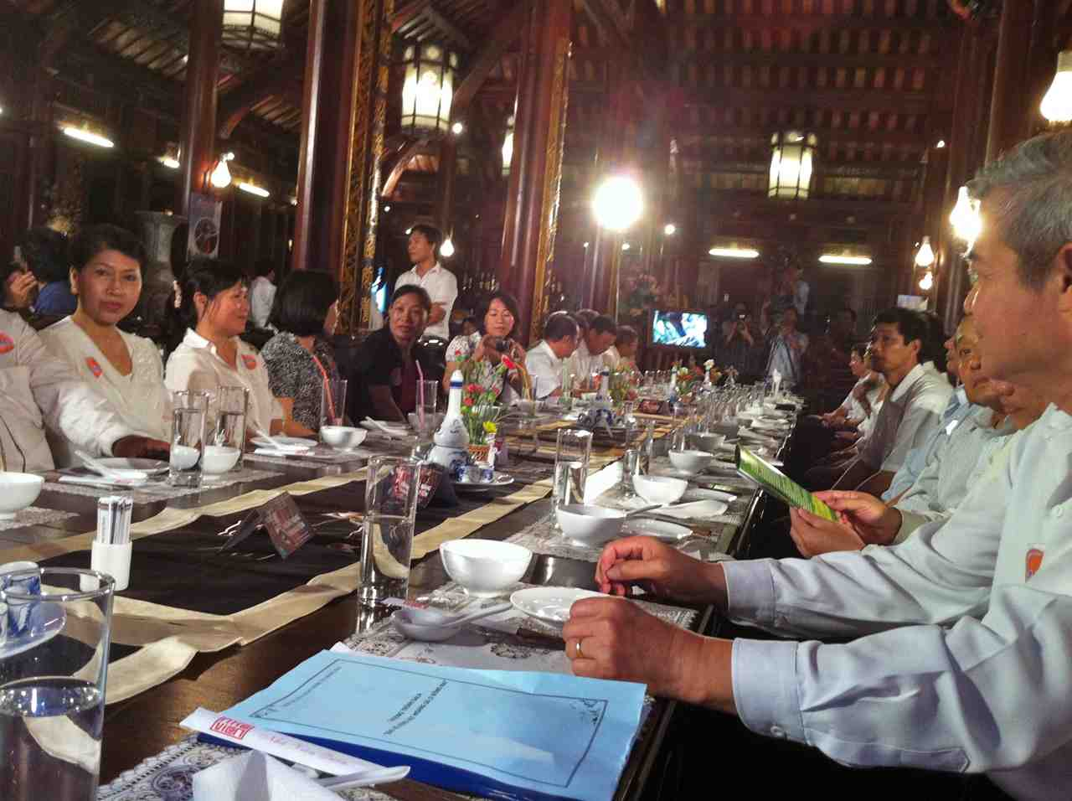
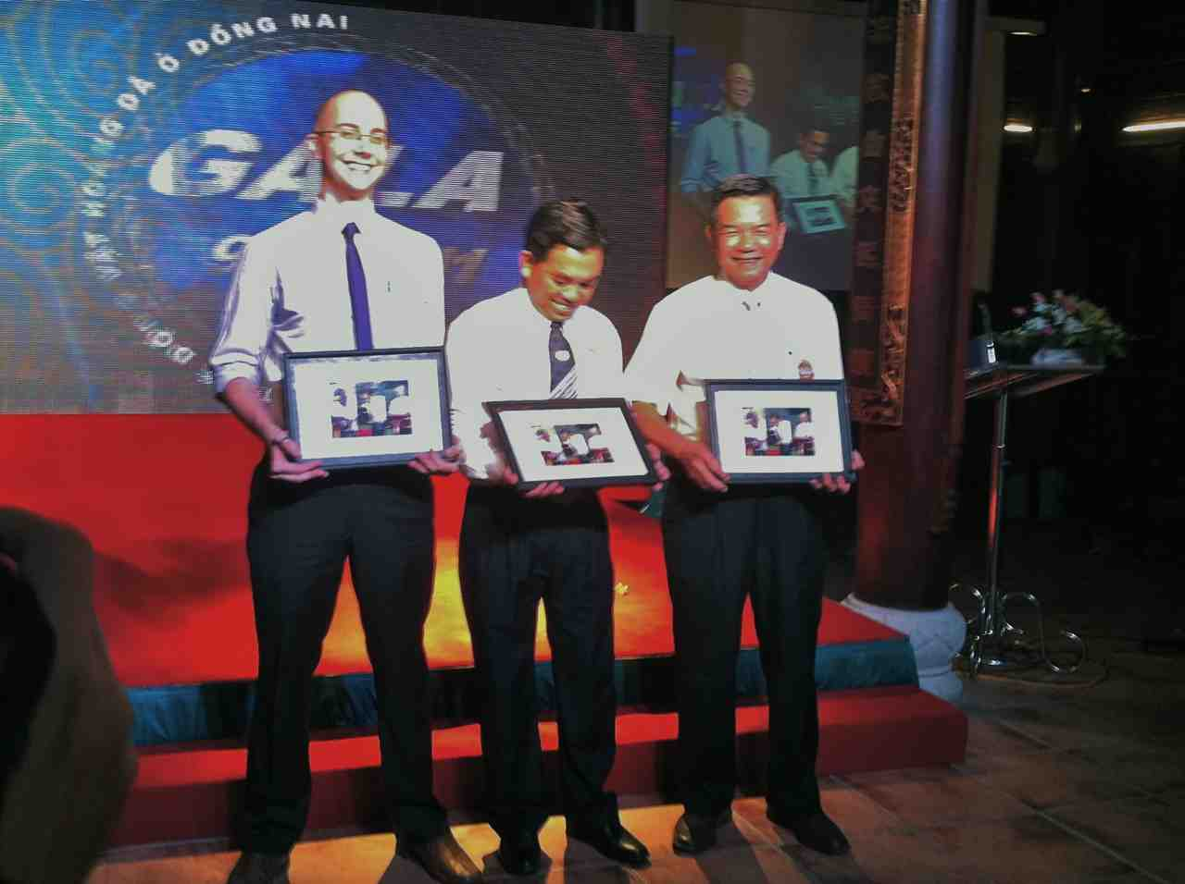
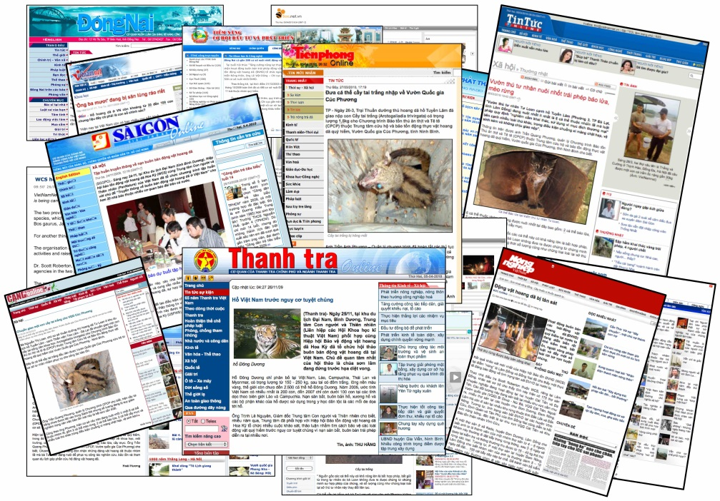
Step 2: Communication of information to relevant agencies via media
Notes:
We also utilise the media to create awareness and pressure for local authorities to take actions.
Above: A gala event where highlevel officials from Dong Nai were invited and took a vow to not to consume wildlife meat
Below, WCS Vietnam communications officer, Dương Việt Hồng (middle right) appeared on the television show 'Live Green' along with the head of HCM FPD (far right) and vice head of Cu Chi Rescue Centre (middle left)
With funds from the USFWS, WCS-Vietnam has catalyzed the writing of twenty-seven local and national media articles on the illegal trade in gibbons and other wildlife since the start of this grant. Please see Appendix 1 for details.

Slide 6
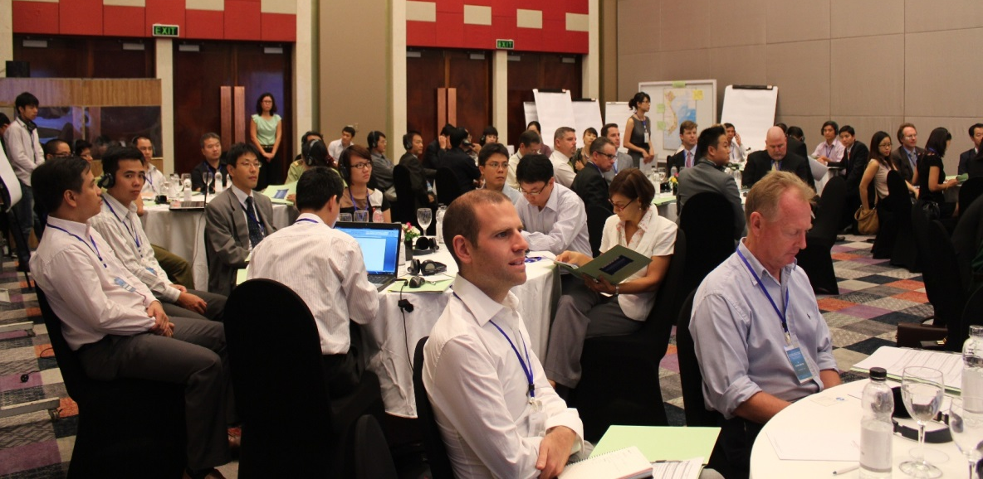
Effective actions yet?
Notes:
Sometimes this will already lead to results, this was the case for the QN project
Results → transnational crimes meeting → actions from Vn and Cn
But for many other cases, we still have to overcome some obstacles. Such as law enforcement capacity, interagency cooperation, or successful prosecutions
HOW DO WE DO THAT?

Slide 7
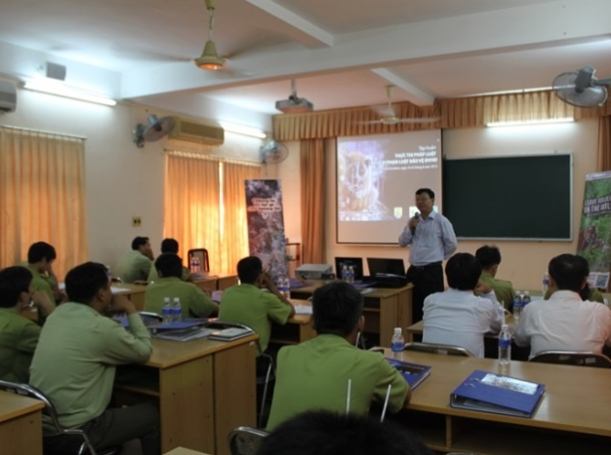
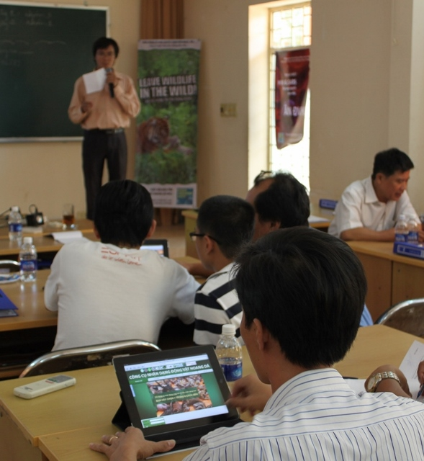
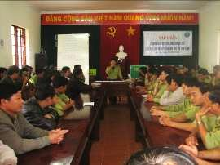
Step 3: Provision of technical support
Notes:
We regularly hold trainings, workshops, and meetings for law enforcement agencies, and we tailor this to their needs:
We train EP and FPD on species ID, inter-agency collaborations,
For procuracy, workshop to review the legal framework and identified loopholes or contradictions within the current legal system
OTJ training to facilitate prosecutions during actual operations
LD FPD officers are briefed on plans to raid wildlife restaurants

Slide 8
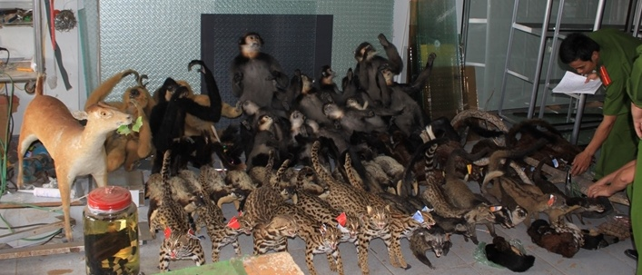
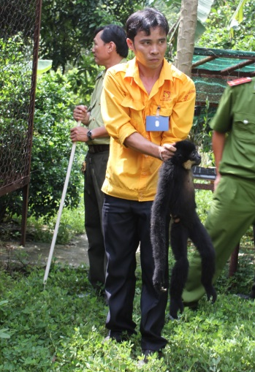
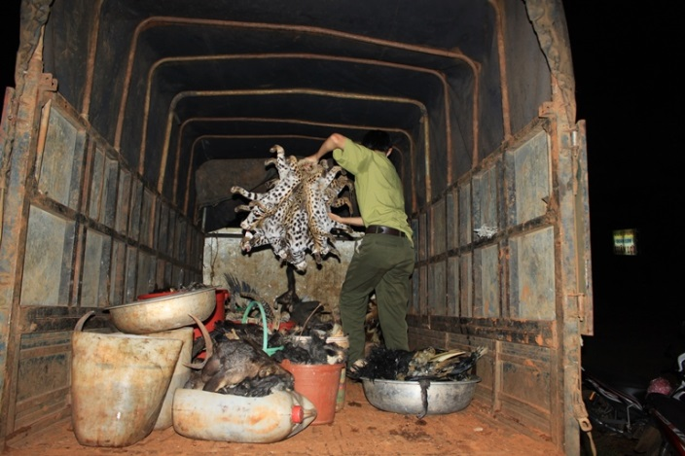
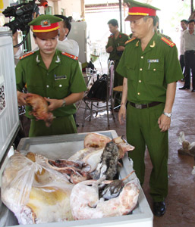
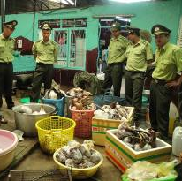
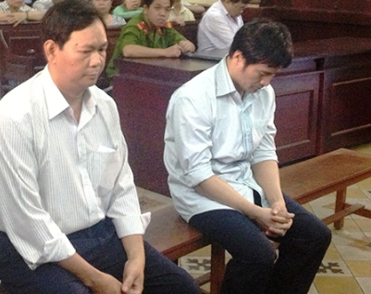
Effective action against trafficking:
Notes:
Dak Nong – one of the largest cases in South vietnam, over 300 specimens confiscated
Rescue of six gibbons in BD from private owners
2 sentenced for ivory trafficking by our trainees from the procuracy workshop
Lam Dong wildlife meat restaurants: LD FPD seized over 300kg of wildlife in Tu Loan’s restaurant.

Slide 9
Provide reliable, quantitative data
Communication
of info to relevant agencies
Effective action against wildlife trafficking by relevant agencies
Provision of technical support:
- Enforcement
- Spp/Product ID
- Agency specific
Identifying who is implicated
International?
National?
Provincial?
Municipal?
Facilitate policy and legislation review
Vietnam media
Sustained WCS activities
Notes:
It is important to maintain this momentum within the provinces, so we must conduct these activities continuously…

Slide 10
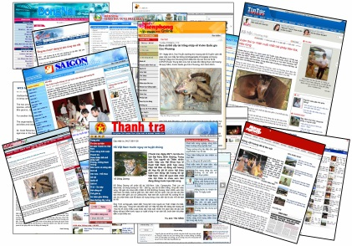
Communication
of info to relevant agencies
Vietnam media
Effective action against wildlife trafficking
Provide reliable, quantitative data
Provision of technical support
Facilitate policy and legislation review

Slide 11
Conclusion
Success depends on a number of factors:
- Local attitude towards wildlife crimes
- Focus from LE agencies
- Interagency relationships
- Resources for LE operations
- Finding the right person from government
Thank you for listening
Notes:
Slide 8: Conclusion
The illegal wildlife trade is a anthropogenic problem, and the solution is within the people.
Each province is different. WCS Vietnam’s approach is to strengthen and influence each part of the link.

