Slide 1
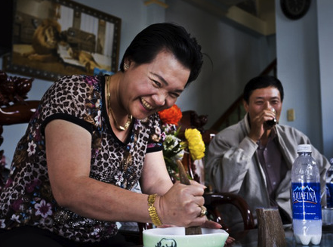
STOPPING THE BUYING:
Strategies to reduce consumption of Endangered Species in Asia
Scott Roberton Ph.D
Wildlife Conservation Society
sroberton@wcs.org / @owstons

Slide 2
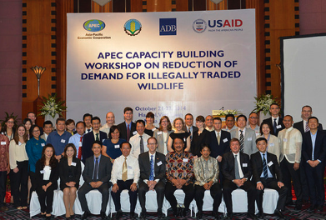
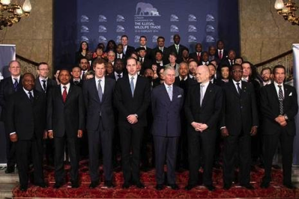
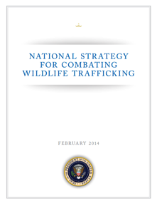
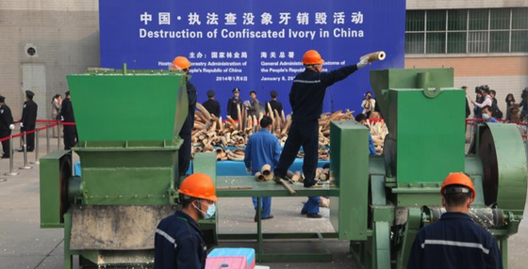
Global attention to address poaching, trafficking and demand for Endangered species has never been greater
Notes:
Collectively, their has been a sharp increase in efforts to respond to wildlife trafficking in recent years.
The US National strategy, the ivory crus, the various intl meetings are all important parts of the picture and help influence other countries to take action

Slide 3
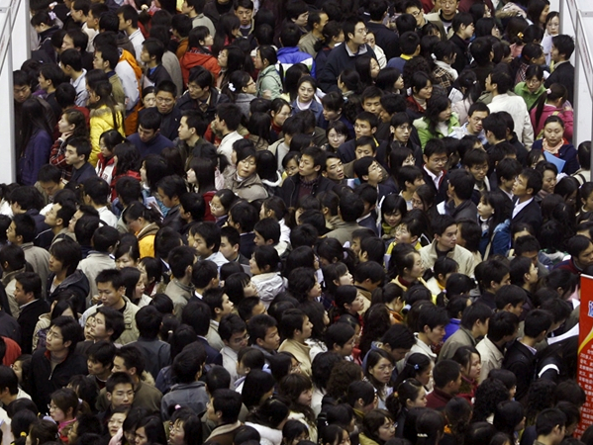
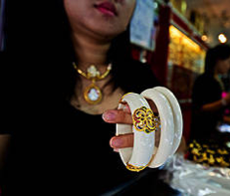
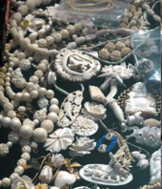
But, what do we really know about consumption?
Robust monitoring is required to enable more accurate measurement of consumption and assessment of demand reduction efforts
Notes:
To what extent are Thai ivory markets selling ivory to Thai people?
Whilst its undeniable that Vietnamese citizens are involved in rhino horn trafficking networks, are we sure they are the end consumer?
How significant is the demand for forest elephant ivory in Japan?
Are we addressing overseas Asian communities?
Repeated, standardized surveys of consumers and an assessment of policies, poaching rates, and enforcement measures

Slide 4
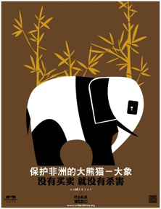
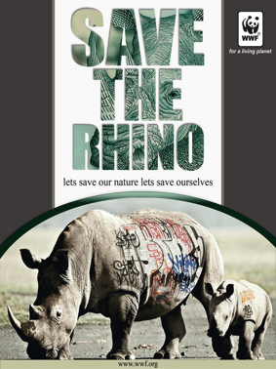
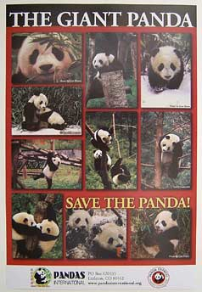
Are consumers listening?
Being aware
≠
Behaviour change
Notes:
Current demand reduction campaigns are heavily focused on awareness-raisin
Consumer awareness campaigns are important for some stakeholders,
In Viet Nam and China whilst consumer awareness-raising initiatives are a critical component to demand reduction, alone they do not provide a comprehensive solution. As we all know, being aware of an issue does not necessarily lead to an attitudinal and/or behavioural change resulting in reduced consumption.
Traditional awareness-raising initiatives (e.g. those using more traditional advertising platforms, PSA etc.), whilst a critical component of long-term behaviour-change campaigns, are demonstrating to be insufficient to reduce consumption and trade of protected wildlife at the timescale required.

Slide 5
Governments action, or inaction are important drivers to changing traditional consumptive behavior
Notes:
Demand reduction requires a multi-pronged approach
The governments of Vietnam and China have made widespread behavioral changes in traditional consumptive practice through policy and law enforcement.
The 1995 ban on firecrackers in VN, a lunar new year tradition going back over a thousand years, was stopped overnight with enforcement and almost no awareness campaigns – the ban remain effective to date.
e.g. The Government of Vietnam has made past widespread changes to traditional consumptive behaviours of its citizens primarily through policy and effective law enforcement. For example, with almost no awareness campaigns, in 1995 Vietnam enacted a ban on firecrackers that had been used for traditional lunar new year celebrations for hundreds of years: the ban remains in force and effective to date.

Slide 6
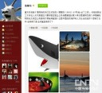
What happened to shark fin trade?
February 20, 2013, MOC Spokesman said the sales of top-grade dishes dropped markedly, with the fins sale down by over 70% around the Chinese New Year period
2011, the CCTV reports led to more proposals which was implicitly connected to the anti-corruption appealing
Latest data in 2014 shows, volume of fins products from Hong Kong to Mainland decreased from 1170 tons in 2012 to 114 tons in 2013
2006-2012, shark protection themed commercials by sport celebrities
2007, WildAid released the “Species Extinction” report on global threats to sharks
2008-2012Entrepreneurs start to have relevant appealing proposals
2000-2001 unaware of shark protection
2009, Nutriological Report on Shark Fins
2002
2006-2012
2013-2014
2002-2003, hydrogen peroxide fins were investigated in Guangdong, resulting in decrease of fin wholesale volume
2007, Yao Ming vowed to “refuse fin dishes under any circumstances”
2011, the OCEANS film inspires the buzz of maritime life protection highlighted by KOLs’ tweets online
July 2012, competent administration under the State Council replied to NPC representative Ding Liguo, expressing to stipulate on the “removal of fin dishes from governmental menus” in three years
2008-2009, top restaurants like South Beauty joined in the “anti-finning” campaign
2010, Canadian & US gov. announced the banning on “fin consumption”
December 2013, the General Office of the State Council issues the administration rules for official receptions, pointing out to refuse the offering of fins, bird’s nest and other top-grad dishes or wildlife dishes for work meals, provision of cigarette and expensive wines, use of private clubs or high consumption venues.
Notes:
Lots o noise on Shark fin in 2012-2014
All started with a hydrogen peroxide fin report in 2002
Celebrities appear along the timeline since 2006.
2010-2014 – Private sector, influential buinessmen entered the field
Shark Fins:
Conservation concern
Public health concern
Austerity and Anti-corruption drive
Biggest change came about when the Government added shark fin to a list of prohibited goods for official receptions

Slide 7
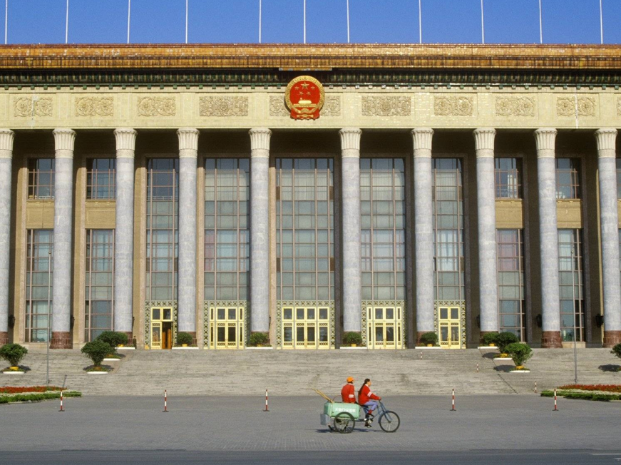
What do ivory consumers think would affect their choices?
source: “The Ivory Road Study” (National Geographic/ifop research), December 2012

Slide 8
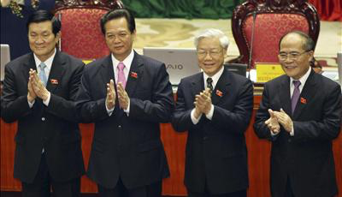
Greater efforts are required to generate the political support for effective crime prevention strategies that will not only have impact on reducing consumption but also strengthen enforcement to combat wildlife trafficking networks.
Notes:
WCS approach:
Supporting the creation, promotion, and implementation of strengthened government policies, and actions to increase the perceived risk for people to partake in the trafficking or consumption of protected wildlife.

Slide 9
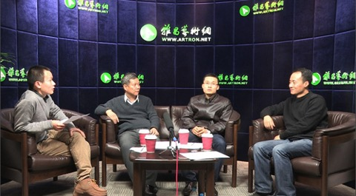
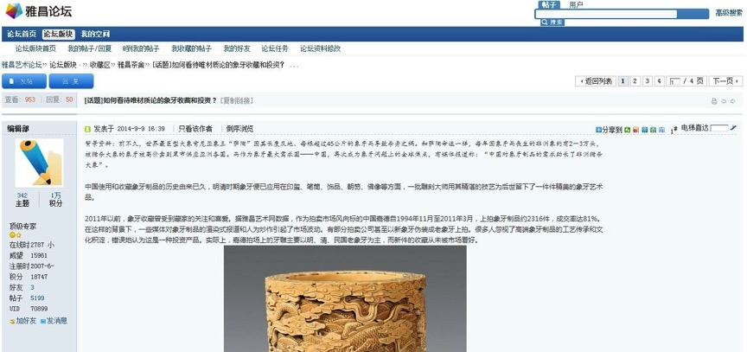
Building an influential, active conservation constituency (Parliamentarians, high-wealth individuals, Government ‘champions’, and media) to strengthern accountability and advocate for policy/legal reforms
Notes:
Artron Online Forum on Ivory Collection: China’s largest art auction database owner to convene discussion on ivory and debate ivory trade

Slide 10
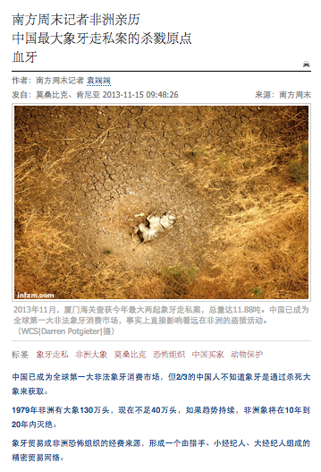
Southern Weekly “Blood Ivory” article
Exposure > 7 million
> 2,382 re-posts
995 comments
Most netizens were from top-tier cities (Beijing, Chongqing, Guangdong).

Slide 11
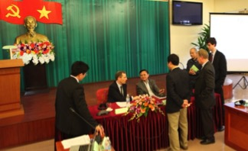
Providing assistance to develop Government strategies and measures that demonstrate political commitment and inform retailers, traders and consumers to the enhanced policy to tackling trafficking and consumption of focal species.
Notes:
change (e.g. increased enforcement response; stockpile destruction; reporting on sentencing, not seizures)
This will also include civil servant training for engagement with domestic and International media and also with domestic journalists and editors of online and print media.

Slide 12
Outreach campaigns to communities living in key African range states to the punishments and scaled-up law enforcement efforts from governments

Slide 13
Generating data and actionable intelligence that enables measurement of impact and changes in attitudes, behavior, policy, law enforcement effectiveness, criminal network integrity
Criminal Justice Statistics
2008-2013: Rhino horn
19 people arrested
1 jailed
6 small fines
12 stopped at prosecution
Notes:
For example, in Vn, WCS has been working with the authorities to promote exactly that, something we are expanding across our programs in Asia.
No additional arrests following interrogation
Primarily transporters (students, migrant workers)
where the limited people actually being arrested are rarely facing a fine or jail term
More Vietnamese people are in jail in SA for Rhino horn than in Vietnam
There needs to be transparency and objective reporting of this sort of data to allow IOs and govts to analyse enforcement effectiveness
Moving past reporting seizures and arrests in reports to measures that inform on enf effectiveness and guide strategies and resource allocations

Slide 14
Assessing social media analytical tools to measure online conversations
WCS Campaign with Customs
WCS Campaign with Customs
WCS collaborated with Artron.net
Ivory Crush
in China
Yaoming Documentary in Africa
The World’s largest ivory storage, by British Daily Mail
Elephants’ poaching in Kenya, by British Daily Mail
HK destroys 28-ton ivory
Kenya elephant king killed crucially
Controversial discussion on China supports terrorism LRA
Notes:
Since September 2013, we have generated:
10 million actual views of posts/articles, with overall exposure (i.e. the number of people’s timelines our content was posted on) estimated to be several times larger.
Hundreds of thousands of online interactions (Commenting, re-tweeting, making statements, posting photographs or drawings in support of elephant conservation) on elephant and ivory related issues as part of various online campaigns;
Ultimately, it’s about how we present the numbers to “influencers” who can make highest impact
Baidu Brand Index is a similar product to Google Trends for brands, which is based on Baidu’s webpage and news search data.
Baidu index is used for keywords research and monitoring search trends in China. You can check the "media exposure" and "users concern" on certain keyword. The data provided is generated from the search queries on Baidu. It offers the latest search behavioral and concern of customers under search queries since June 2006. Since Baidu is the biggest search engine in China, the data it provided is reliable for the use of content optimization, and can represent the trend of market.

Slide 15
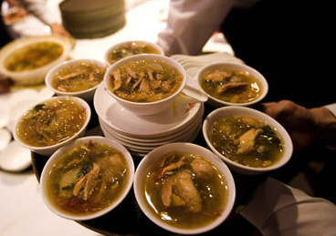
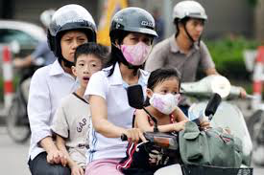
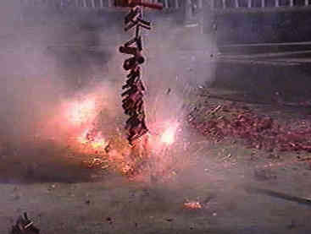
?
Notes:
Motorbike helmets in Vietnam:
Public health concern
Business interests
Pressure from bi-lateral Aid agencies and lenders
PM affected emotionally from awareness campaigns
All three have impacts on consumers to varying degrees – but to affect choices in short-term the government can make the greatest immediate impacys

