Slide 1
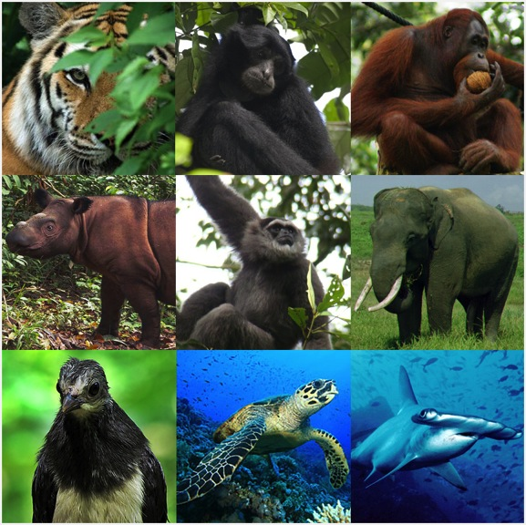
WCS Indonesia:
the
Wildlife Crimes Unit
WILDLIFE CONSERVATION SOCIETY
Indonesia Program
Jl. Atletik No. 8, Bogor – Indonesia

Slide 2
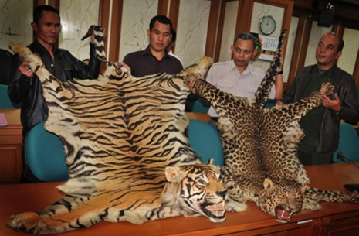
WILDLIFE CRIME UNIT
A unique partnership of Government Agencies, Civil Society Organisations, Volunteer Informant Networks and the Media, facilitated by WCS, dedicated to combatting illegal wildlife trade in Indonesia
Media
AJI Lampung, Lampung Post, Radar Lampung, The Jakarta Post, Lampung TV, Metro TV, Trans TV, TV One, Radar Lampung, Kompas, ANTARA, Oke Zone, Kompas Cyber Media, Jakarta Globe.
Government:
Ministry of Forestry:
Direktorat PPH, Direktorat KKH Ditjen PHKA
BKSDA (Lampung, Sumatera Utara, DKI Jakarta, Jawa Barat, Jawa Tengah, DIY, Bali)
National Parks
Indonesian National Police:
Criminal Investigation Division (CID),
POLDA Jateng, POLDA Lampung, POLDA Aceh,
NCB Interpol
Customs (Direktorat Pencegahan dan Penindakan Bea Cukai)
Attorney General (Lampung, Sumatera Utara and Jakarta
Quarantine (Serang, Bakauheni)
Military (Kodam IV Diponegoro, POMDAM Iskandar Muda, Sub POM Lhokseumawe)
NGOs
RPU (Rhino Protection Unit), Vesswic, OIC, SOCP, LASA (Lembaga Advokasi Satwa), IAR (International Animal Rescue), JAAN (Jakarta Animal Aid Network), Forum HarimauKita, Yayasan Kanopi Indonesia, ZSL.

Slide 3
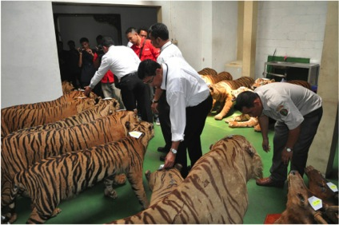
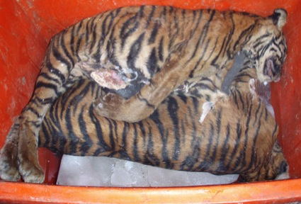
MAIN ACTIVITIES
Investigation and law enforcement support
Court process assistance
Monitoring illegal wildlife hotspots
Training and capacity building
Campaign and outreach
Media publications

Slide 4
Numbers | Notes
WCU has investigated 600 different cases. | Early cases (2003-2005) focused on about 100 minor wildlife criminals
Of those 600 cases, the GoI has taken law enforcement action on 252 | GoI now acts on 40% of WCU cases, up from 10% of cases in 2003. WCS started training judges, police and prosecutors on wildlife crime laws, and as a consequence the GoI began acting on more and more cases.
Of those 252 cases, 240 led to successful law enforcement action (either confiscation or arrest). | The high success rate of arrests is a testament to the thoroughness of the investigations done by the WCU
Of those 240 successful law enforcement actions, over 220 lead to successful prosecutions. | National average for arrest to prosecution ratio for wildlife crimes is 5%. Wildlife crimes cases brought by WCU have an arrest to prosecution ratio of over 90%. This is a testament to the quality of the investigations and the quality of legal assistance the WCU provides.
These 220 successful prosecutions include about 120 confiscations, but also include over 100 poachers and traders, including many major kingpins of wildlife trade | The WCU is now targeting larger and larger actors in the wildlife trade networks. The top 10 wildlife crime cases in Indonesia were all catalyzed by the WCU
WCU by numbers:
The Wildlife Crimes Unit has catalyzed the successful arrest and prosecution of hundreds of wildlife criminals

Slide 5
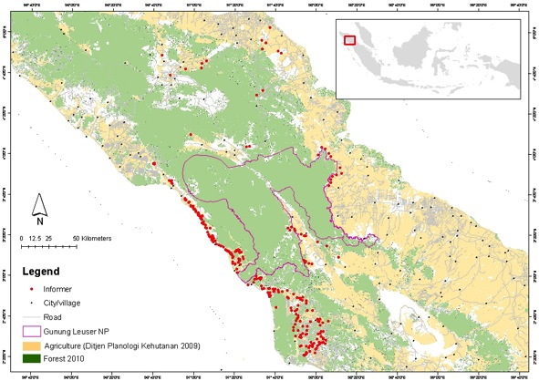
Informants help gather information
Informants are:
Heads of village in target landscapes (no payment)
Local people in target landscapes or trade points (paid based on information)
Volunteer informants, e.g. student clubs in Jakarta (no payment)
Full hired informants (monthly payment)
Government officers in target landscapes/cities (no payment)
Anyone who gives information to WCS (unknown people)

Slide 6
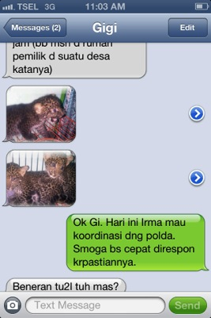
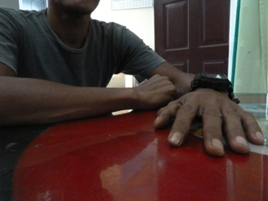
WCS investigators gather and verify information
hidden camera
Investigations can include SMS interactions with traders to build trust
Face to face meetings while wearing hidden cameras
These cameras can obtain incriminating proof

Slide 7
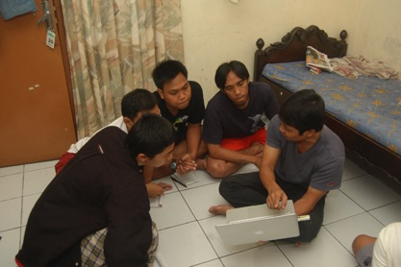
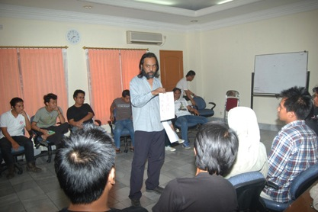
Trained 45 WCS investigators
Regularly trained by Criminal Investigation Division trainers. Trainings include:
sneaking wildlife through airport customs
detecting corruption in hospital’s outpatient process
buying drugs from inmates in prisons
physical & security mapping in hotels
many other exercises
Criminal Investigation Division trainer
The trainings are extremely rigorous - only 10% of the trainees pass all the tests to become a WCS investigator

Slide 8
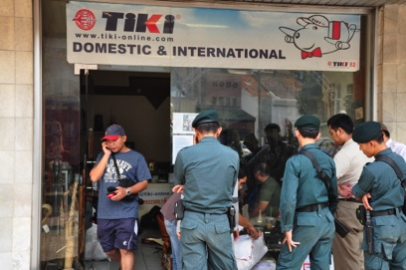
Stings
Safety is major priority. No WCS persons have ever been injured in any operation. The police know and approve all sting operations beforehand. 3-5 WCS and/or government staff always involved. Safety protocol also includes:
Extensive training on cover stories
Ensuring information is extremely siloed (criminal targets see as few WCS staff faces as possible. The police also only know the identities of a small number of WCS staff)
Exit strategies
Safe houses
Backup from high ranking police, Military and/or Ministry of Forestry

Slide 9
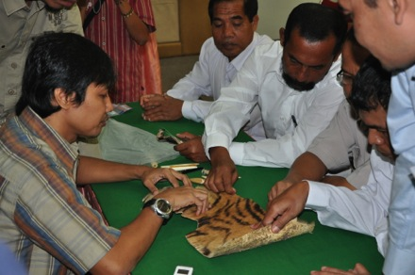
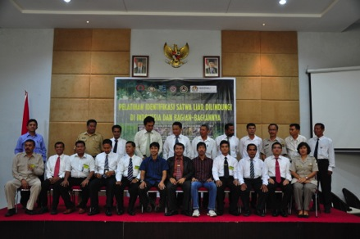
Training police investigators, prosecutors and judges increases the number of cases acted on by the GoI
WCS staff on left teaching the intricacies of wildlife law to GoI staff on right
Due to GoI staff turnover, it is necessary to hold many training sessions
WCS also is a partner on USG-funded programs:
General trainings for law enforcement agencies (under ICITAP)
Development of guidelines for prosecutors on wildlife crimes (under USAID-C4J)
Development of training modules for prosecutors on wildlife crimes (under USAID-C4J)

Slide 10
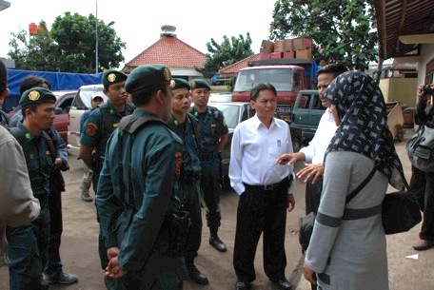
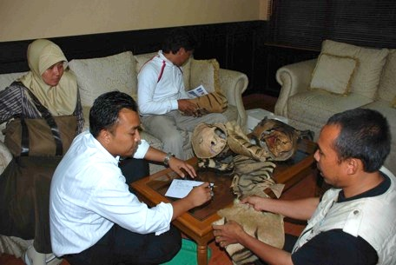
Legal assistance is provided throughout a case
WCS legal advisor
WCS legal advisor
WCS legal advisors help the GoI ensure cases are done according to the law. Here a WCS legal advisor prepares the police on proper procedures just before the operation to capture a suspect (previously identified by WCS).
Once a suspect has been captured WCS legal advisors ensure evidence is properly handled by Government officials.

Slide 11
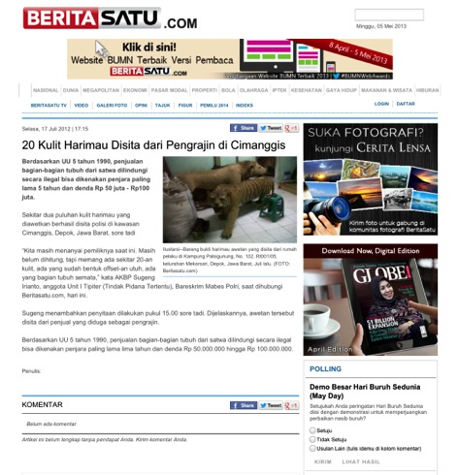
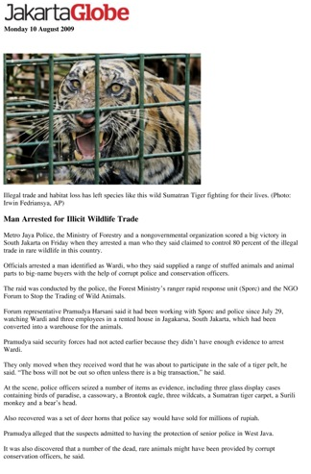
Harnessing the media is critical for success
~80% in Indonesian language
~20% in English language

Slide 12
Listing names of good police, prosecutors and judges – this helps with their promotions and rewards success

Slide 13
When WCS senses a case is going to be corrupted it calls in the media
Notes:
"I indicated there are allegations of conspiracy bargaining height of the defendant that the verdict came out 18 months in prison", said Chairman of the Institute for Animal Advocacy Irma, through release told AFP on Friday.

Slide 14
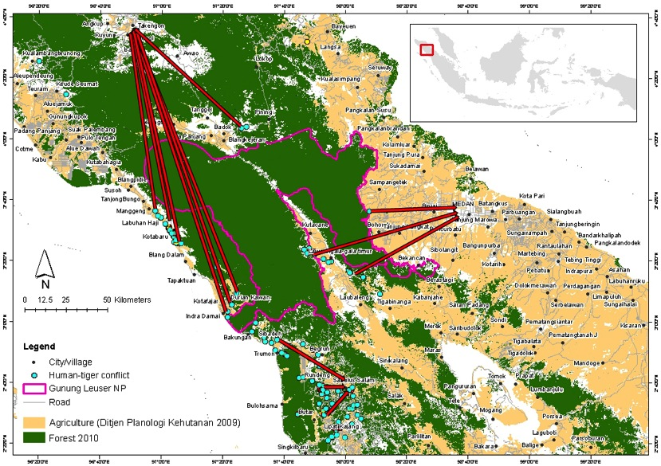
Example case – in Leuser, WCS mapped out a tiger trade network
Trade route of 13 tigers in Leuser in 2007 (before WCS began work). Each red line represents one tiger. The trader in the north lived in a town called Takengon.

Slide 15
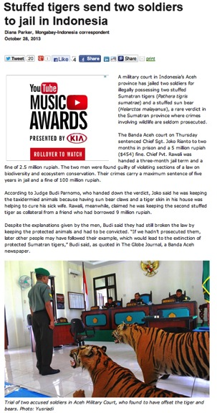
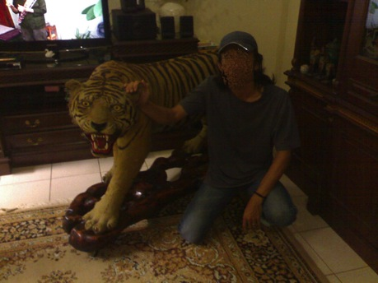
In 2013, WCU (WCS and Indonesian Military Police) successfully prosecuted the Takengon trader, who was a military sergeant
Undercover agent gathering evidence
Arrest and confiscation in March 2013. Successful prosecution in October 2013
WCS supplied approximately 1000 man-hours on the case.

Slide 16
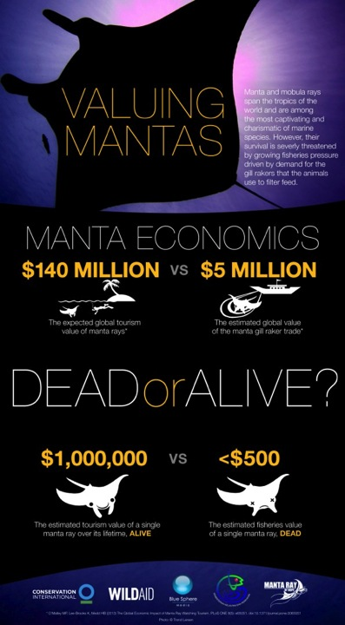
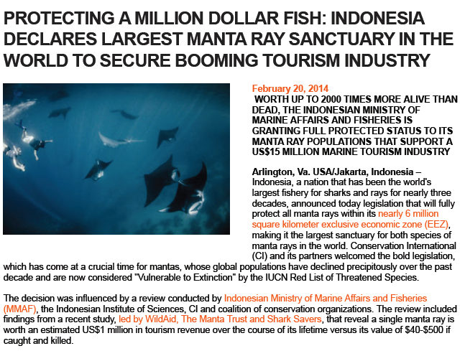
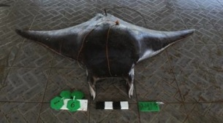
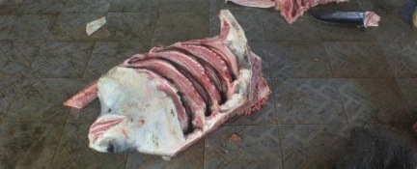
New Directions? Marine-WCU

Slide 17
New Strategic Opportunities
Extend the WCUs: expansion of the WCU approach to other important wildlife landscapes and important wildlife species in Indonesia
Apply WCU approach to other sectors: e.g. illegal timber trade or forestry and the trade in manta rays and sharks
Legal reform: Indonesia’s laws on illegal and legal wildlife trade and application of international conventions are inconsistent and have various loopholes:
It is not illegal to transport non-native species through Indonesia (including African Ivory)
The ‘Manta Ban’ is outside of the formal protected species list and hence cannot be prosecuted by the National Police
Domestic application of CITES is weak
Training and capacity-building to government agencies: e.g. revision of the National Police environmental crimes training modules
Supporting the GoI to establish a high-level forum to discuss wildlife trade (legal and illegal) and propose cross-sectoral strategies
South-south cooperation: GoI – Government of Vietnam MoU

Slide 18
TERIMA KASIH
Funders: United States Fish and Wildlife Service (USFWS), USAID-C4J, ICITAP, Liz Claiborne and Art Ortenberg Foundation, TFCA, American Zoological Association, WCS

