Slide 1
CITES and the International Wildlife Trade
Why engage?
How to engage—nationally, regionally, internationally
CITES Committees and processes
Animals Committee
Standing Committee
MIKE, ETIS

Slide 2
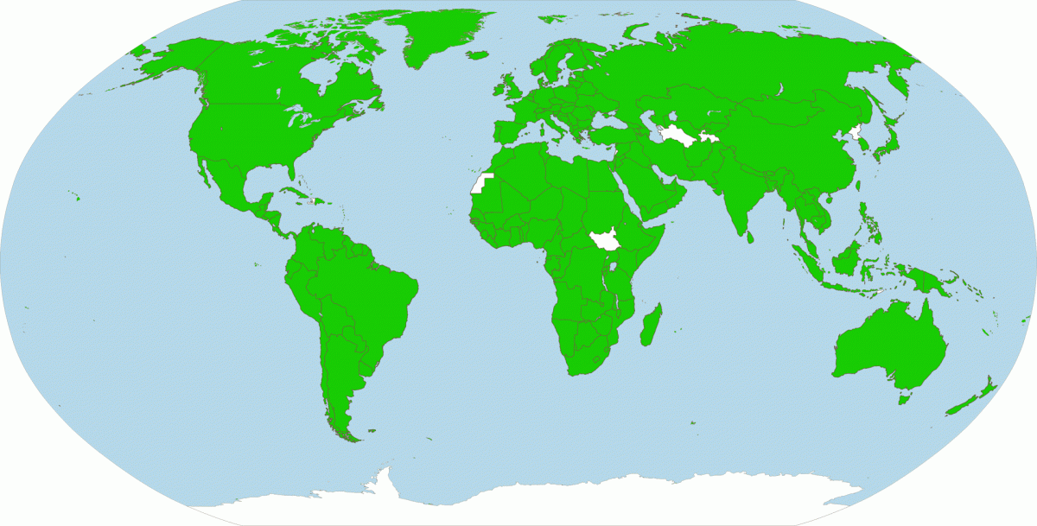
What is CITES?
Convention on International Trade in Endangered Species of Wild Fauna and Flora
First negotiated in Washington DC.
Signed March 1973; entered into force July 1975.
180 countries are ‘Parties’ (members)
Regulates international trade in listed species
₂

Slide 3
History of CITES
Some treaties that pre-date CITES
1900. London Convention Designed to Ensure Conservation of Various Species of Wild Animals in Africa Which Are Useful to Man or Inoffensive
1911. North Pacific Fur Seal Convention. Regulated over-exploitation of fur seals at sea and on land
1933. London Convention Relative to the Preservation of Fauna and Flora in Their Natural State.
1940. The Washington Convention on Nature Protection and Wild Life Preservation in the Western Hemisphere. Washington
1946. International Convention on the Regulation of Whaling. Washington, D.C.

Slide 4
1948. Founding of the International Union for the Protection of Nature (IUPN), forerunner of IUCN; Fontainebleau, France. Backed by UNESCO.
1949. First United Nations Conservation Conference: UN Scientific Conference on the Conservation and Utilization of Resources (UNSCCUR). Lake Success, Long Island, New York. Called for international legislation "to maintain nature's equilibrium" and listed "gravely endangered species.”
1960. IUCN General Assembly resolution called for international convention regulating trade in endangered wildlife species (driven by trade in cat furs).
1963. IUCN called for convention regulating "export, transit, and import of rare or threatened wildlife species ….“
1964. IUCN prepared a first draft of a convention.

Slide 5
1972. UN Conference on the Human Environment. (Stockholm Conference) Establishment of UNEP.
1973. CITES agreed: the Washington Convention.
1975. CITES Entry into Force. Charter Parties: Canada, Chile, Cyprus, Ecuador, Nigeria, Sweden, Switzerland, Tunisia, USA, and Uruguay.
1976. First CITES meeting of the Conference of Parties (CoP1). Berne, Switzerland. Adopted the Berne Criteria for listing species, which required evaluation of both biological and trade status.

Slide 6
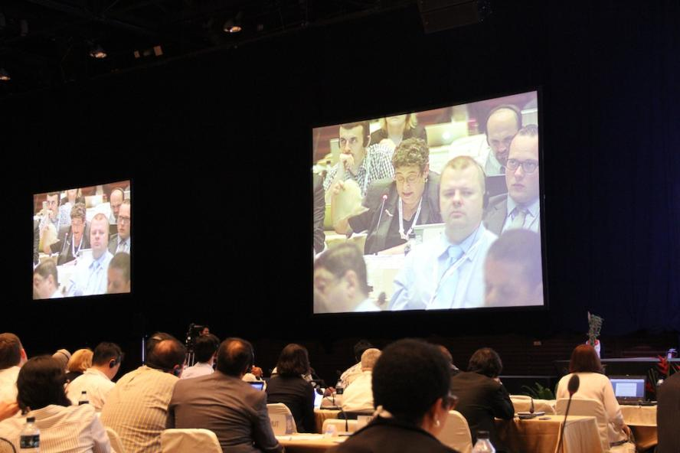
CITES meetings of the
Conference of the Parties
CoP1 1976 Bern, Switzerland
CoP2 1979 San Jose, Costa Rica
CoP3 1981 New Delhi, India
CoP4 1983 Gaborone, Botswana
CoP5 1985 Buenos Aires, Argentina
CoP6 1987 Ottawa, Canada
CoP7 1989 Lausanne, Switzerland
CoP8 1992 Kyoto, Japan
CoP9 1994 Fort Lauderdale, USA
CoP10 1997 Harare, Zimbabwe
CoP11 2000 Gigiri (Nairobi), Kenya
CoP12 2002 Santiago, Chile
CoP13 2004 Bangkok, Thailand
CoP14 2007 The Hague, The Netherlands
CoP15 2010 Doha, Qatar
CoP16 2013 Bangkok, Thailand
CoP17 2016 South Africa
₆

Slide 7
Provisions of CITES
Regulates trade through inclusion of species in 3 appendices
Requires Parties to establish Management and Scientific Authority
Establishes Secretariat to administer treaty
Holds biennial meeting of Party countries
Notes:
The main provisions of CITES are as follows:
CITES regulates trade by including species in one of three appendices. Each appendix has a different level of protection and/or permit requirements.
CITES requires its Parties to establish one or more Management Authorities competent to grant permits or certificates on behalf of that party, and one or more Scientific Authorities.
CITES establishes a Secretariat for purposes of administering the Convention. The CITES Secretariat is based in Geneva, Switzerland.
CITES holds a biennial meeting of all Party countries in order to conduct a variety of business, including voting on various proposals to amend the three appendices. This meeting is called the Meeting of the Conference of the Parties. The eleventh meeting of the Conference of the Parties is scheduled for Nairobi, Kenya in April 2000.

Slide 8
Appendix I
Species threatened with extinction, which are or may be affected by trade
International trade for commercial purposes prohibited
Import permit and export permit or re-export certificate required
Currently includes about 900 species

Slide 9
Appendix II
Species which may become threatened with extinction unless trade is subject to strict regulation
Commercial trade permitted under controlled circumstances
Export permit required
“Similarity of Appearance”, Article II.2.b.
other species which must be subject to regulation in order that trade in specimens of certain species referred to in sub-paragraph (a) of this paragraph may be brought under effective control
Can help prevent unsustainable trade, or even promote sustainable trade
About 33,000 species listed-- many subject to significant commercial trade

Slide 10
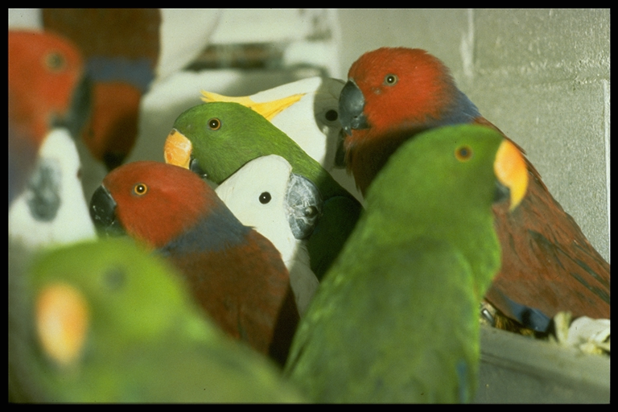

Slide 11
Appendix III
Species that are protected in at least one country, which has asked other CITES Parties for assistance in controlling the trade.
Commercial trade is allowed; it is more of a compliance Appendix than a conservation one (no conservation finding)
Listings are unilateral
It has been used as a “transitional” Appendix

Slide 12
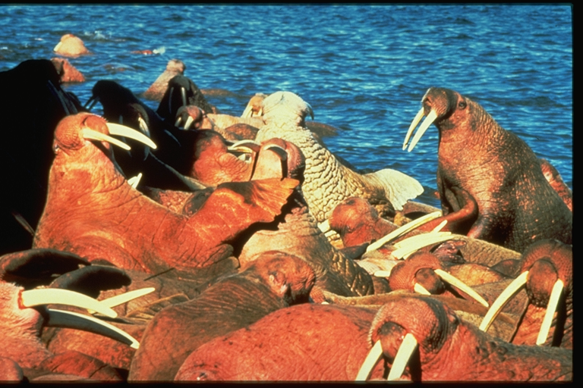

Slide 13
>35,000 species, mostly plants, most in trade
 | Appendix I | Appendix II | Appendix III
FAUNA
Mammals | 300 spp. (incl. 11 pops) + 23 sspp. (incl. 3 pops) | 501 spp. (incl. 16 pops) + 7 sspp. (incl. 2 pops) | 45 spp. + 10 sspp.
Birds | 154 spp. (incl. 2 pops) + 10 sspp. | 1278 spp. (incl. 1 pop) + 3 sspp. | 25 spp.
Reptiles | 80 spp. (incl. 8 pops) + 5 sspp. | 673 spp. (incl. 6 pops) | 40 spp.
Amphibians | 17 spp. | 126 spp. | 3 spp.
Fish | 16 spp. | 87 spp. | -
Invertebrates | 63 spp. + 5 sspp. | 2162 spp. + 1 sspp. | 22 spp. + 3 sspp.
FAUNA TOTAL | 630 spp. + 43 sspp. | 4827 spp. + 11 sspp. | 135 spp. + 13 sspp.
FLORA | 301 spp. + 4 sspp. | 29592 spp. (incl. 162 pops) | 12 spp. (incl. 2 pops) + 1 var.
GRAND TOTAL | 931 spp. + 47 sspp. | 34419 spp. + 11 sspp. | 147 spp. + 13 sspp. + 1 var.
Source: www.cites.org. Updated 2 Oct. 2013

Slide 14
How does CITES work?
Governments declare CITES Management and Scientific Authorities
Parties must report their trade in CITES-listed species
Special requirements for trade in live specimens
To trade Appendix II species:
Permit required from the Management Authority of the exporting country
Permits must be based on findings of non-detriment and legal acquisition
Parties are required to have implementing legislation with enforcement provisions (including penalties, confiscation, etc).
To amend the Appendices
Parties submit proposals
Parties vote on proposals at the Conference of the Parties
To be adopted, a 2/3 majority of those voting is required

Slide 15
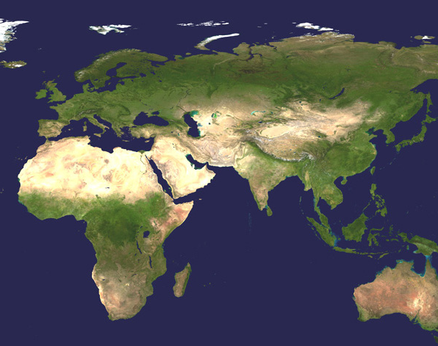
Elephas maximus
Loxodonta cyclotis
Loxodonta africana

Slide 16
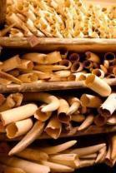
VERY abridged CITES history
1976: Ghana listed it in Appendix III
1977: Included in Appendix II
1985 Quotas required, due to poaching escalation
1989 included in Appendix I at CoP7
USA market (15%) vanishes, Europe down
Effective at reducing poaching, illegal trade, in many countries
1997 Split listing
Botswana, Zimbabwe, Namibia populations to App II
One-off sale approved
2000 South Africa population to App II
2002 strong conditionality on future sales
2007 sale of 60 tons from Botswana, Namibia, S Africa to Japan (and later China).

Slide 17
History of Listing Very abridged
2007 (CoP14) Zambia, Tanzania submit proposals for downlisting. Tanzania withdraws, Zambia rejected
2010 (CoP15) Zambia, Tanzania submit proposals for downlisting.
CITES Secretariat recommends allowing Zambia be approved
CITES Secretariat rejects similar request by Tanzania.
Proposals rejected

Slide 18
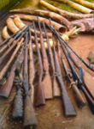
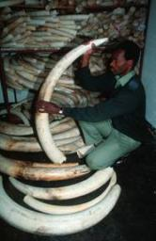
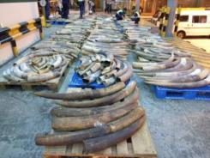
ETIS & MIKE
CoP10 1997 CITES Parties mandate
Comprehensive international monitoring system to track illegal trade in elephant products (ETIS)
Key countries/regions in Africa: Central Africa (DR Congo, Cameroon), Nigeria, Angola, Mozambique and Egypt
Key countries in Asia: Thailand, Myanmar, China
Field based effort to monitor law enforcement efforts and illegal killing of elephants (MIKE)

Slide 19
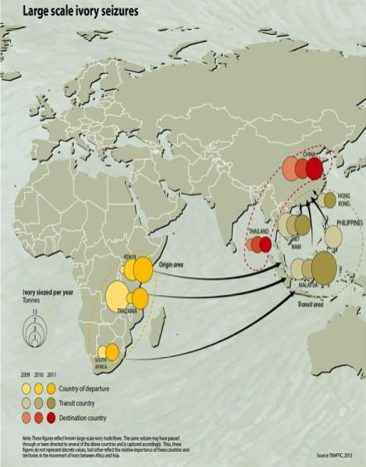
8 worst countries must produce action plans
Kenya, Tanzania, Uganda,
Malaysia, Thailand, Philippines
Vietnam, China
CITES: possible sanctions in 2014 for non-compliance
Stop the Trafficking
Notes:
Work by TRAFFIC and WCS shows that 3 countries in Africa appear to account for most illegal ivory exports (although this doesn’t indicate the source of the ivory). Vietnam, Hong Kong, and Malaysia are key transit points and Thailand and China are the principal consumer countries.
WCS is working with the secretariat of the UN Convention on International Trade in Endangered Species to push for CITES sanctions – that is a ban on all listed species, including timber.

Slide 20
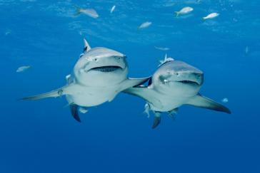
CITES Processes
Animals Committee
Next meeting April 28 – May 3 (Mexico)
Can drive policy outcomes, action
Key agenda points at this meeting for WCS:
Review of Significant Trade
Illegal trade in cheetahs
Snake trade and conservation management
Tortoises and freshwater turtles
Shark conservation and management
Freshwater stingrays
Review of the Appendices
Bushmeat
Compliance and enforcement

Slide 21
CITES Processes
Standing Committee
Next meeting 7-11 July 2014 (Geneva)
Potential—major policy decisions, actions
History, examples (rhinos, tigers)
Key agenda points at this meeting for WCS:
Elephants, ivory, 8 countries
China, Thailand; Malaysia, Hong Kong, Philippines, Viet Nam; Kenya, Tanzania, Uganda
Tiger trade
Illegal wildlife trade, ICCWC
August 2015 meeting
CoP17: South Africa, 2016

Slide 22
Standing Committee members
Norway
Hungary
Portugal
Ukraine
US
Indonesia
Japan
Kuwait
Botswana
Egypt
Niger
Uganda
Colombia
Dominica
Guatemala
Australia
Thailand (last host)
South Africa (next host)
Switzerland (depositary)

Slide 23
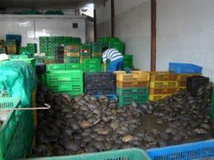
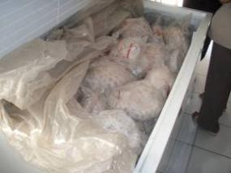
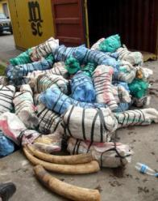
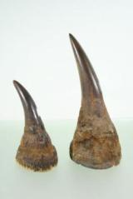
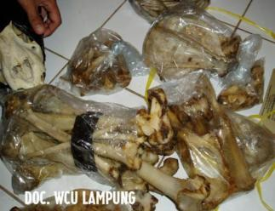
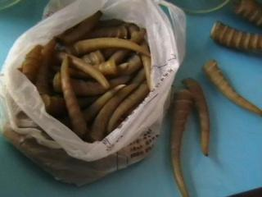
Wildlife trafficking--what is happening today?
Poaching and trafficking in highly valuable body parts is:
increasingly run by organized criminal syndicates;
driven by high prices, particularly in East Asia; and
facilitated by corruption, weak governance and low capacity all along the trade chain, from source to market.

Slide 24
Policy engagement
Provincial/local level
National level
International level: regional
International level: global, intergovernmental
Use policy engagements & deliverables to:
Drive conservation outcomes (species, places, etc.)
Drive actions by governments
Foster relationships (governments, donors, media)
Build political momentum, political will

Slide 25
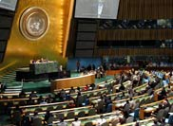
Beyond CITES Other fora, organizations that we can influence on wildlife trafficking
IUCN, World Parks Congress
UNGA
Possible UNGA Resolution
Sustainable Development Goals; post 2015 development agenda
Access to 193 governments at high level
UNODC, UNCTOC

Slide 26
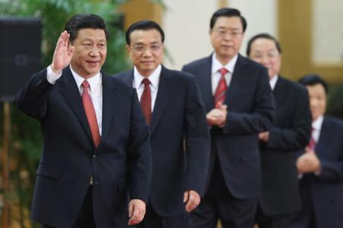
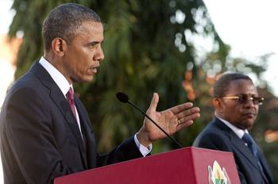
Advocacy, Communications
Goal: Influence senior leaders & stimulate action by governments

Slide 27
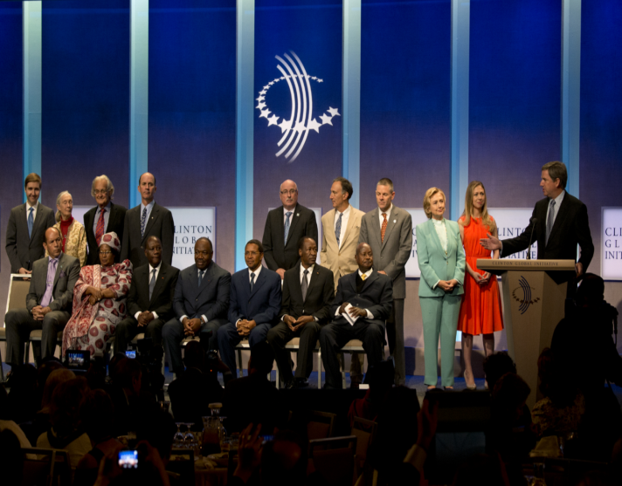
Botswana
Burkina Faso
Cote d’Ivoire
Gabon
Kenya
Liberia
Malawi
South Sudan
Tanzania
Uganda
Zambia
Clinton Global Initiative Sept. 26, 2013
Advocacy & communications

Slide 28
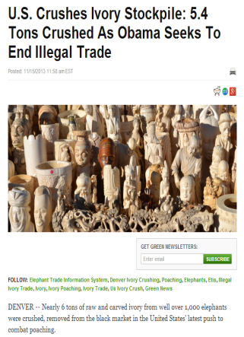
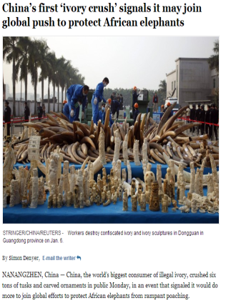
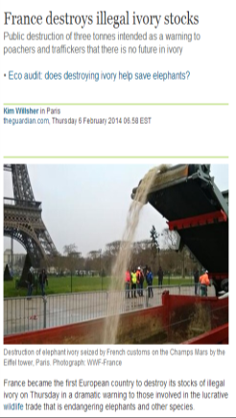

Slide 29
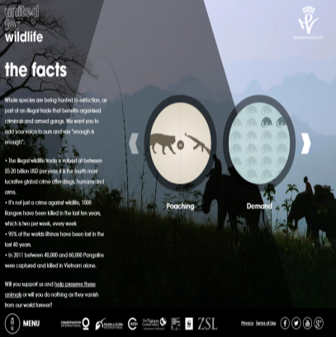
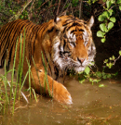
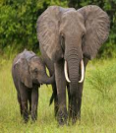
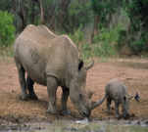
United for Wildlife
Royal Foundation and 7 largest conservation organizations
CI, FFI, IUCN, TNC, WCS, WWF, ZSL
www.unitedforwildlife.org
London Symposium: Feb. 2014

Slide 30
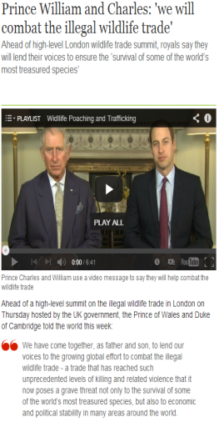
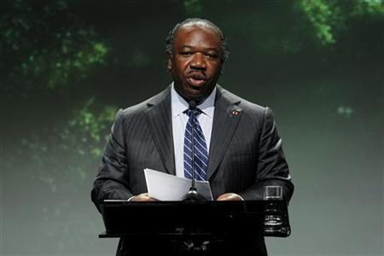
London Summit (Feb. 2014)
President of Gabon
Ali Bongo Ondimba
Heads of State and Ministers
from 50 countries
Adopted the
London
Declaration
“Last year we burned our entire stockpile of ivory to show that Gabon has no tolerance for this”
Next Summit: 2015, Botswana

Slide 31
EU
Strategy consultation, process
April 10th meeting, Brussels
Policy engagement, funding potential
UK, Germany
National strategies, funding, engagement, diplomatic efforts
UN missions
Embassies in countries

Slide 32
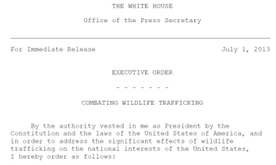
US
Presidential Executive Order
Task Force
Advisory Council
National Strategy
Next steps

Slide 33
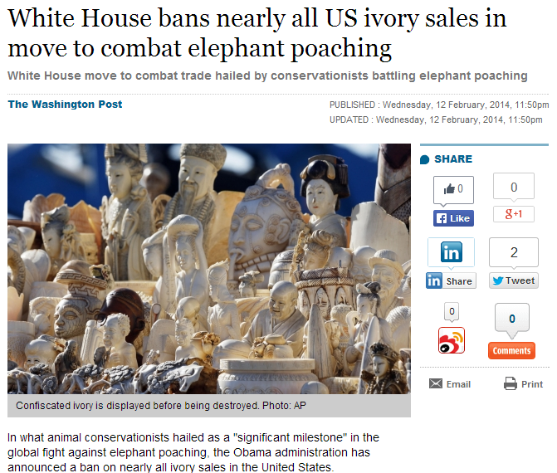
Ongoing work on implementation of the Strategy

Slide 34
US Government
How is it organized?
How can you engage?
US Embassies and Consulates
Visiting government officials
Visiting Members of Congress and their staff
US government officials at international meetings

Slide 35
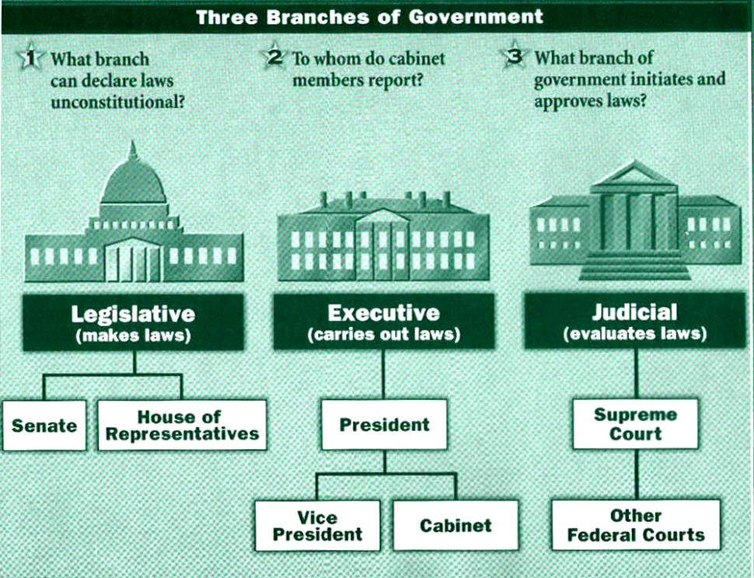

Slide 36
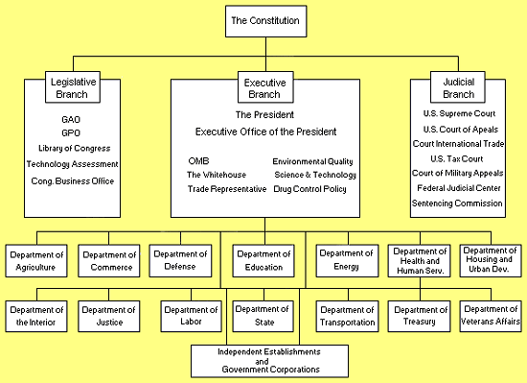

Slide 37
US Executive Branch Departments of relevance to WCS
Department of State
OES, INL
USAID
Embassies & Missions
Department of the Interior: FWS, NPS
Department of Commerce: NOAA
Department of Defense
Department of Homeland Security (Customs)
Department of Justice

Slide 38
