Slide 1
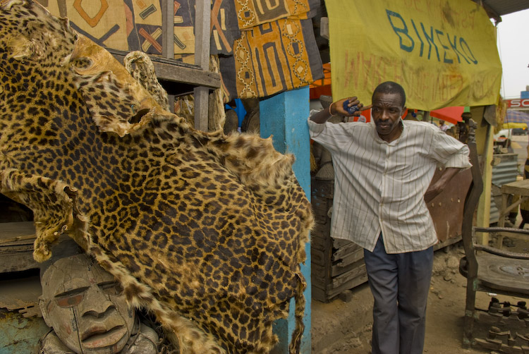
To trade or not to trade?
Opportunities for,
and limitations to, sustainable trade
in wildlife
Elizabeth L. Bennett
19th June 2015

Slide 2
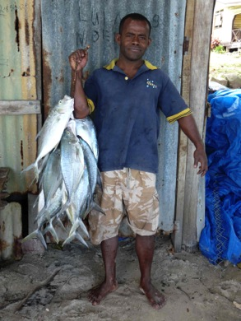
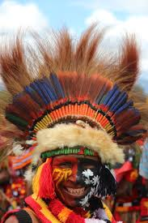
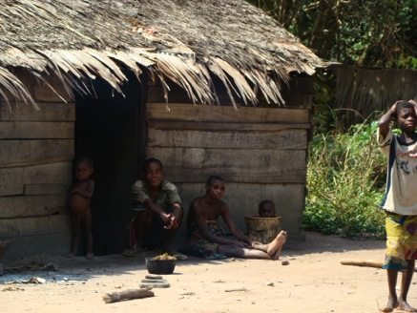
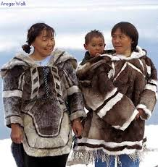
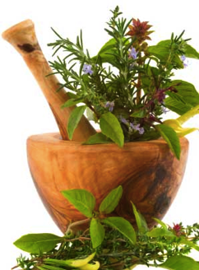
Since the dawn of our species, we have exploited other species.

Slide 3
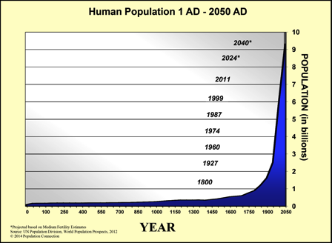
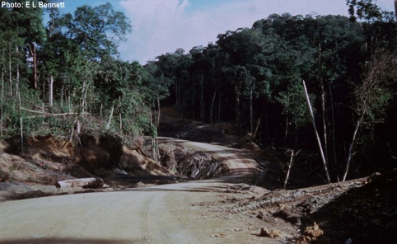
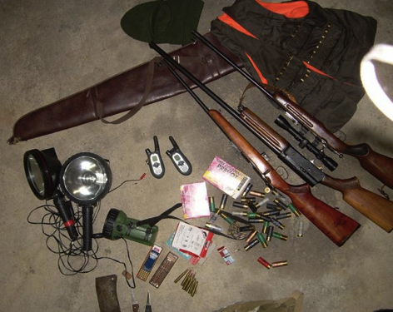
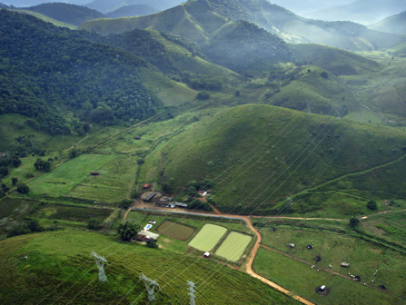
But many factors are now changing very rapidly.

Slide 4
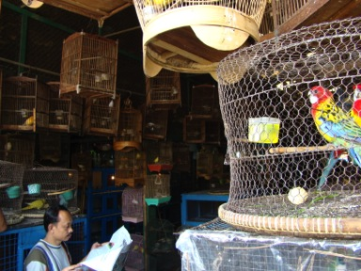
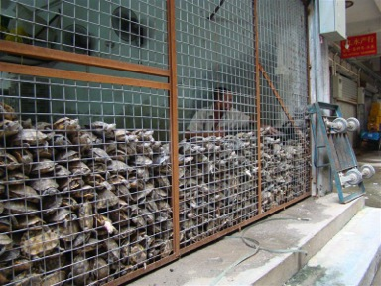
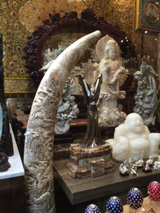
Commercialization. That, in today’s globalized world, is potentially the most challenging – demand can exceed sustainable supply by many orders of magnitude.
This talk focuses on terrestrial vertebrates – many of the species of conservation concern today.
Commercial wildlife trade: “Characterized by transport and sale of wildlife in a way that requires capital investment, operates over long distances (greater than a hunter would walk in a day), and involves middlemen or re-sellers.” (CBD and CIFOR, 2008.)

Slide 5
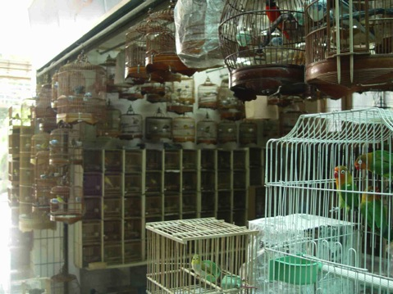
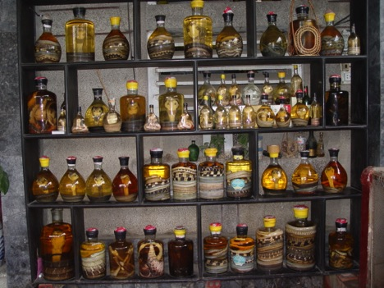
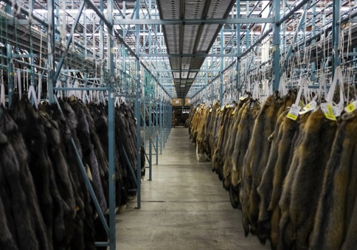
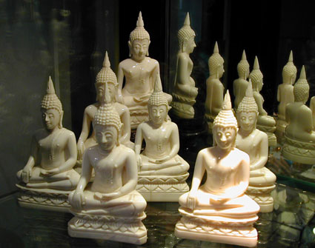
It involves a huge variety of species and uses.

Slide 6
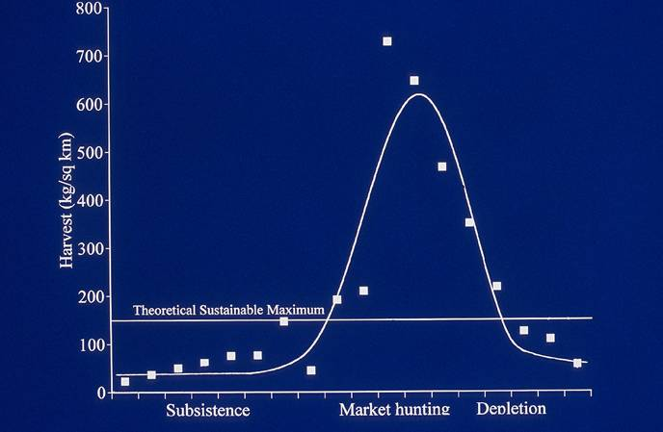
Without appropriate management, as hunting is more for sale, we get typical “boom and bust” wildlife trade. E.g., bushmeat trade….
Degree of commercialization
Bennett et al. 2002

Slide 7
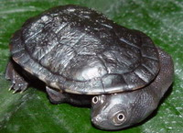
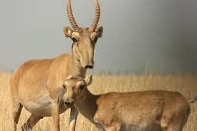
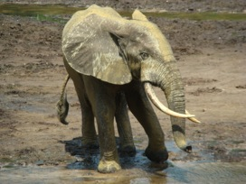
Pet trade. Roti Island snake-necked turtle went from discovery to commercially extinct in ten years.
Rhodin et al. 2008
Traditional medicine trade. Saiga lost >95% of its total population in 15 years.
Milner-Gulland et al. 2001
2002-2013, 65% of African forest elephants lost.
Maisels et al. 2013

Slide 8
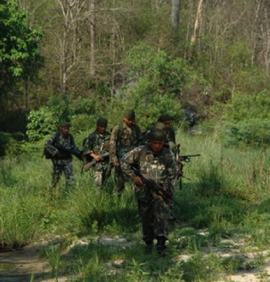
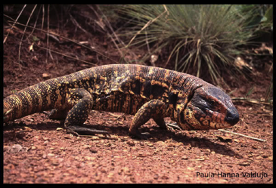
Species in demand for commercial trade can be conserved by protection against trade….
Or programmes of sustainable use.
Both have been successful under different circumstances, and both also have their challenges.

Slide 9
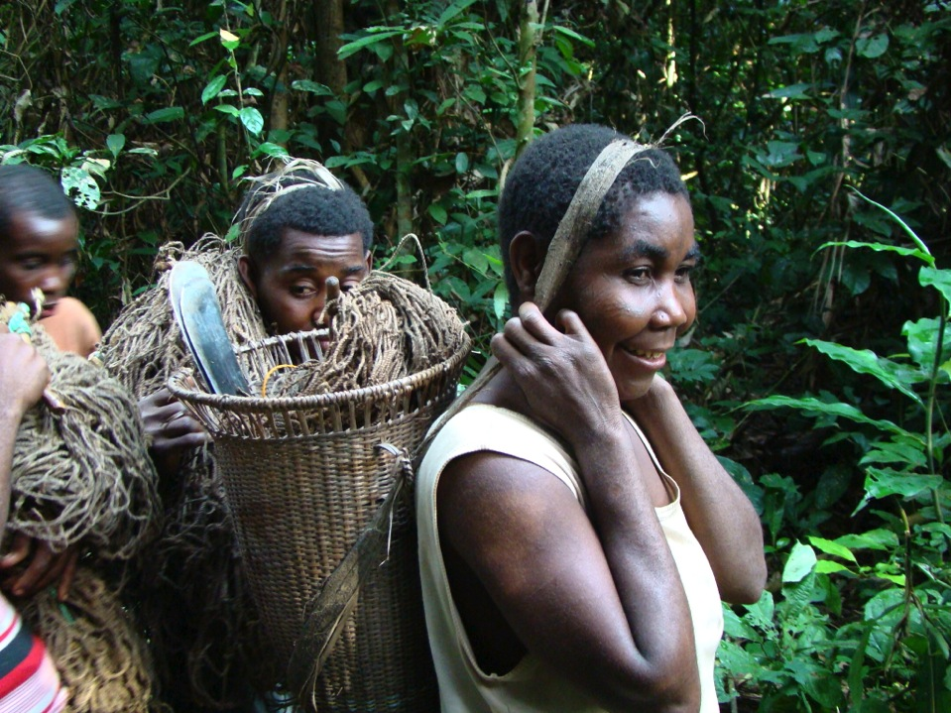
If either approach is to succeed, local communities must be involved. Wild places that are often the source of harvested wildlife are also often home to some of the world’s poorest and most marginalized people. Both wildlife and people need good governance, security, and ways to manage over-exploitation by outsiders.

Slide 10
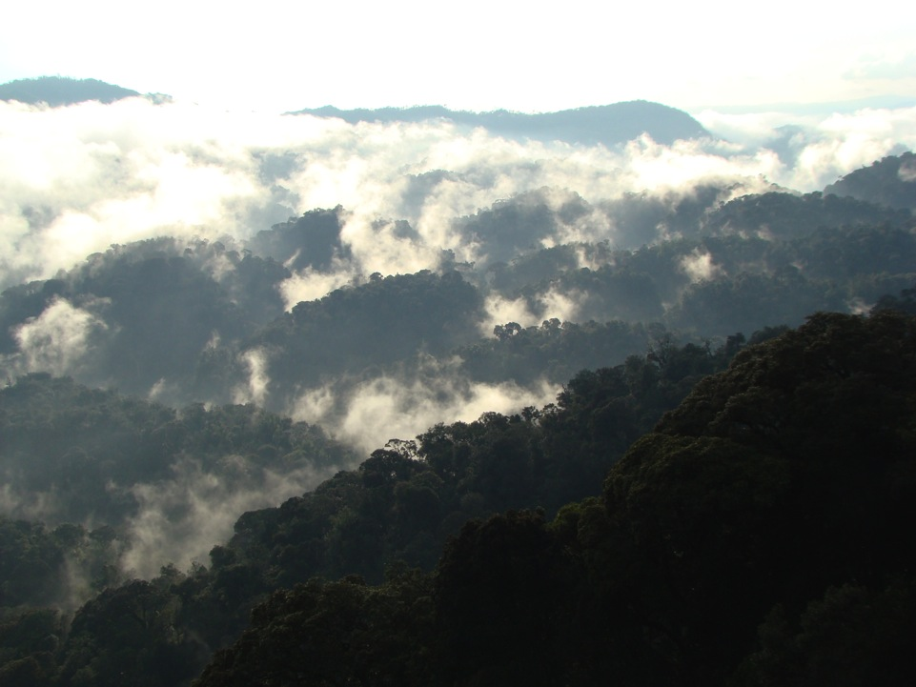
This paper explores the conditions under which sustainable use or protection is likely to be the more effective approach to conserving a species in the face of commercial demand.

Slide 11
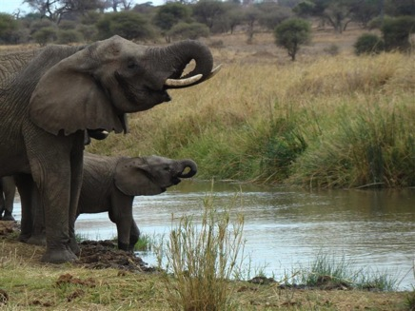
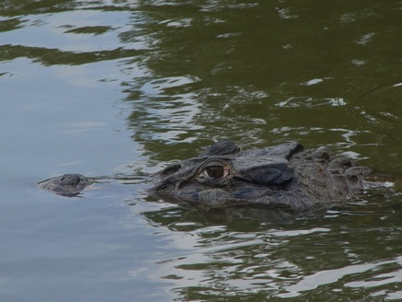
To trade or not to trade? Biological considerations
Managing a sustainable trade for species with low intrinsic natural rates of increase is more challenging than….
for species whose productivity is high.
Especially if demand for the species is high.

Slide 12
Productivity is linked to rainfall and habitat: mammalian productivity is an order of magnitude greater in savannahs than tropical forests….
Robinson & Bennett 2004

Slide 13
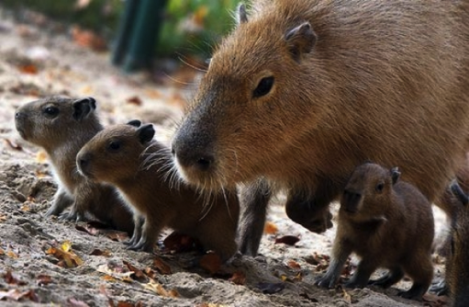
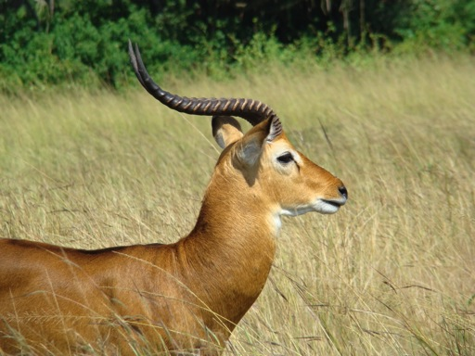
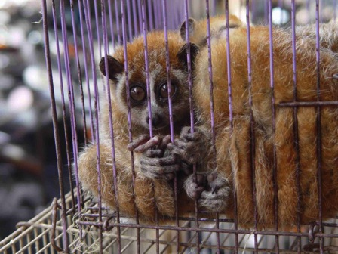
Which is why most successful examples of sustainable use are from more productive systems.

Slide 14
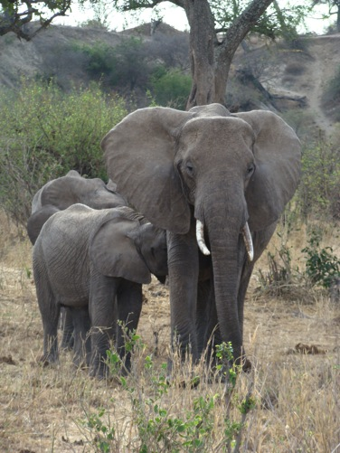
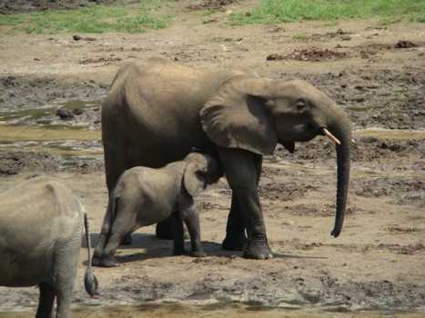
Although in savannahs, productivity of African savannah elephants is relatively low….
And that of African forest elephants is even lower.

Slide 15
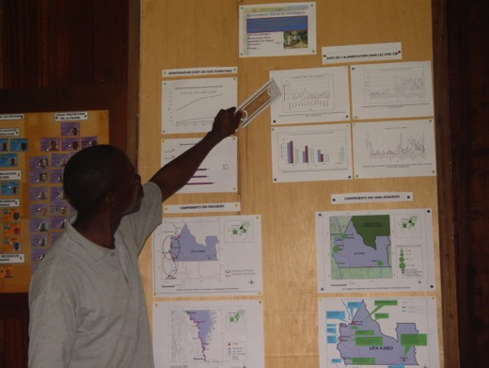
To trade or not to trade? Management considerations
Both sustainable use and protection require good management capacity, including monitoring -- of populations, trade, and markets. And that can be done in many ways.
That capacity might lie with local communities, government, NGO, or some combination of them.

Slide 16
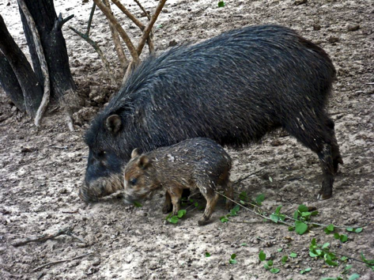
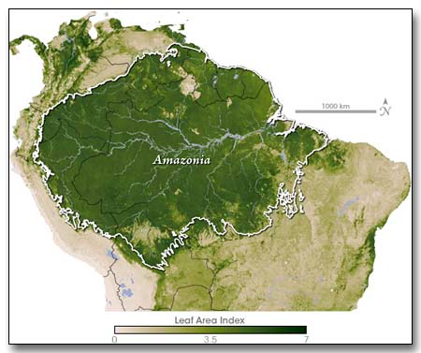
Sustainable trade requires greater capacity than protection, to ensure chain of custody of sustainably sourced products -- to ensure that sustainable trade from one place does not result in unsustainable trade from others.
Certification systems, with good chains of custody, might be needed to prevent this. If leakage from more vulnerable areas cannot be controlled, attaining sustainability is more challenging.
???

Slide 17
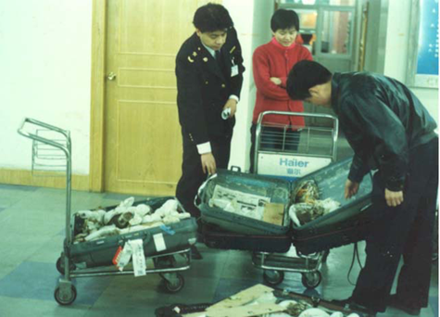
Sustainably sourced??

Slide 18
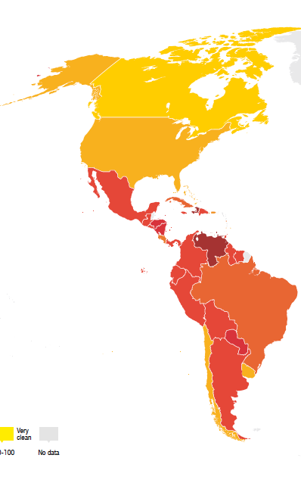
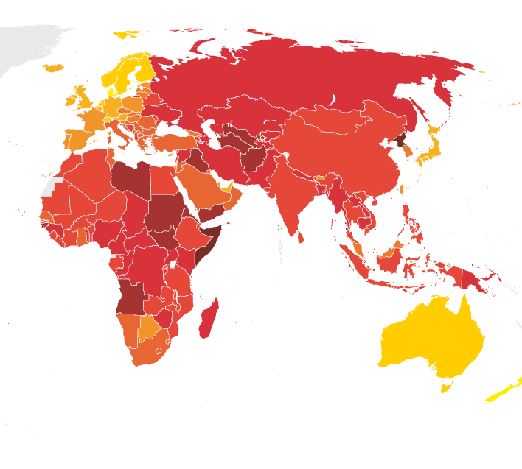
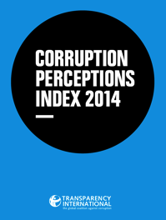
To trade or not to trade? Governance considerations
This is primarily a concern for high value species (i.e., high profit per unit item). Management of a sustainable trade in high-value wildlife is especially challenging in the face of low capacity and weak governance along potential trade chains.

Slide 19
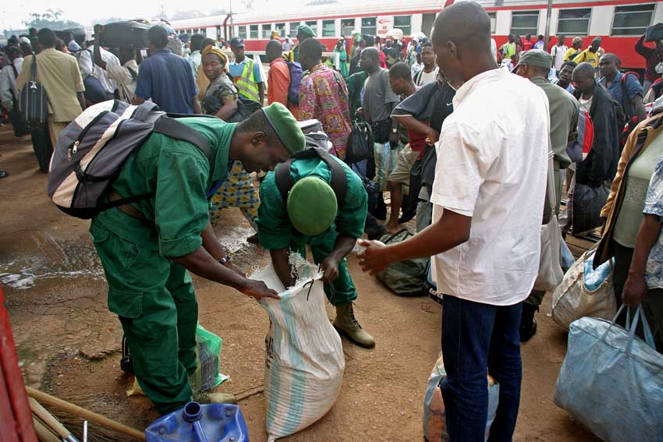
Wildlife officials are vulnerable to corruption – poorly paid, sometimes unpaid for months.

Slide 20
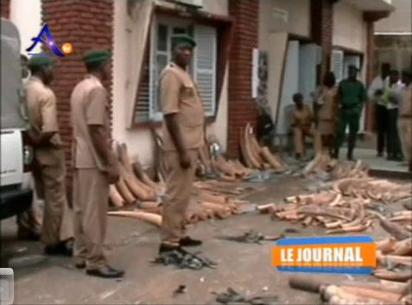
In Cameroon, bribes attempted in 85% of field cases, and 80% of court cases.

Slide 21
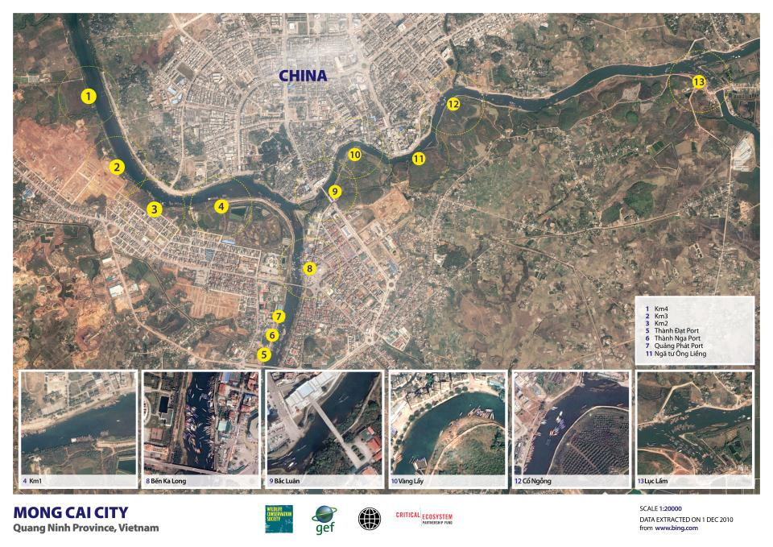
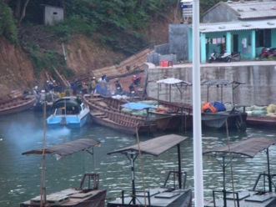
On Vietnam–China border, $18,000- $30,000/day paid in bribes.
©WCS Vietnam

Slide 22
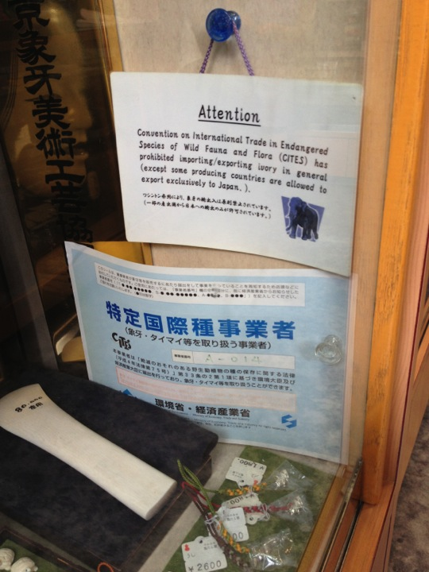
False, altered, or abused legal documents are a further problem for high-value wildlife.

Slide 23
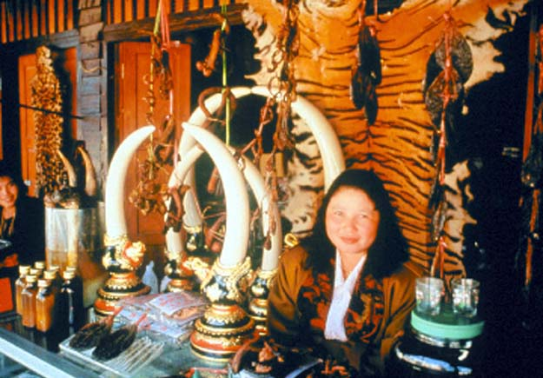
Within that context, it is difficult or impossible for law enforcement officers to distinguish legal from illegal products, and to control a sustainable trade.

Slide 24
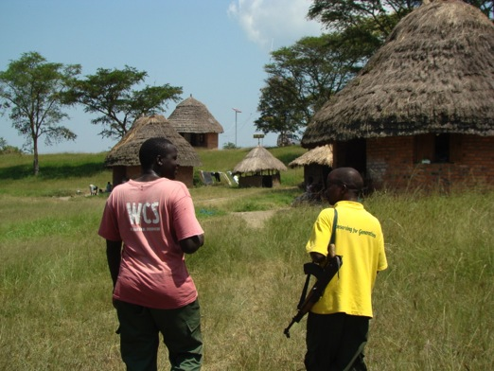
To trade or not to trade? Conclusions
For wildlife valued in trade, good management is needed – whether for sustainable use, or strict protection.
Management can be by governments, local communities, NGOs, or some combination, and may operate at different points along the trade chain.
But in every case, to be effective, the managers must have the legal mandate to manage, management capacity, and funding.

Slide 25
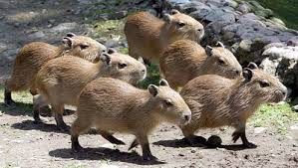
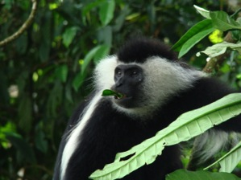
So, to trade, or not to trade? The decision on which option is more likely to have a positive conservation outcome for the species should be influenced by:
1. Biology of the species
High productivity: Sustainable trade is easier to achieve.
Low productivity: Achieving sustainable trade is more challenging.

Slide 26
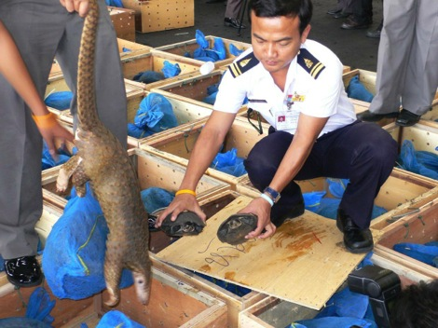
2. Management capacity along the trade chain to track chain of custody
Capacity strong: Sustainable trade is easier to achieve.
Capacity weak: Achieving sustainable trade is more challenging.

Slide 27
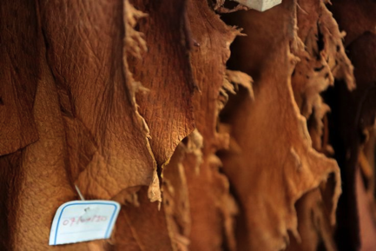
3. Governance
Low individual item value, corruption is not a concern: Sustainable trade is easier to achieve.
High individual item value, corruption is a concern: Achieving sustainable trade is more challenging.

Slide 28
A sustainable peccary skin trade is potentially feasible: high productivity, low value, good management capacity in many areas.

Slide 29
A sustainable ivory trade is challenging from all viewpoints: low productivity, high value, low management capacity in many areas, and weak governance across trade chains. Hence, a legal trade cannot currently be controlled at present, and strict protection is the only way to conserve elephants across much of Africa until these factors change.

Slide 30
Thank you!

