Slide 1
Current WCS Action on Wildlife Trade in Lao PDR
Soubanh silithammavong

Slide 2
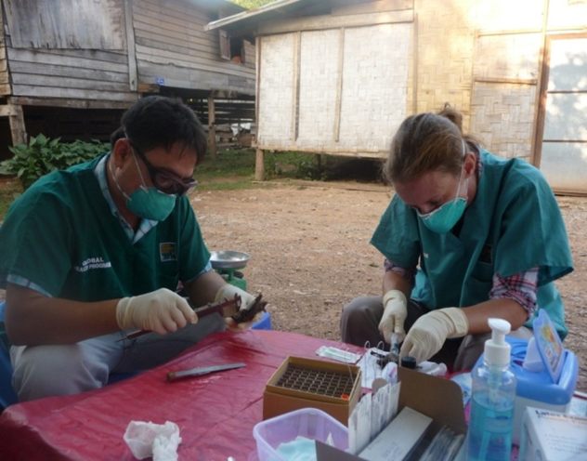
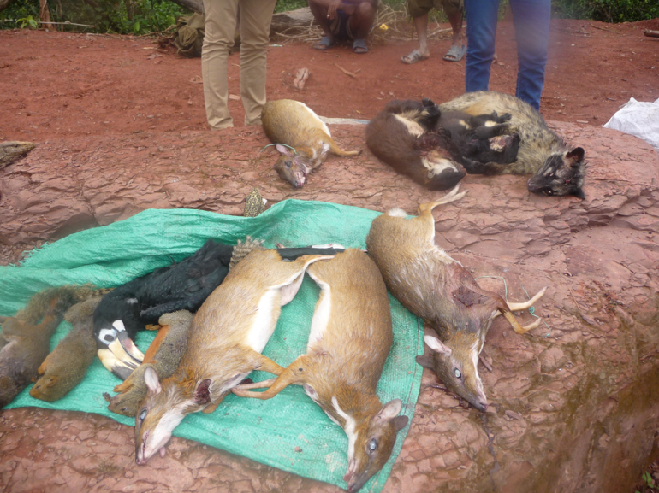
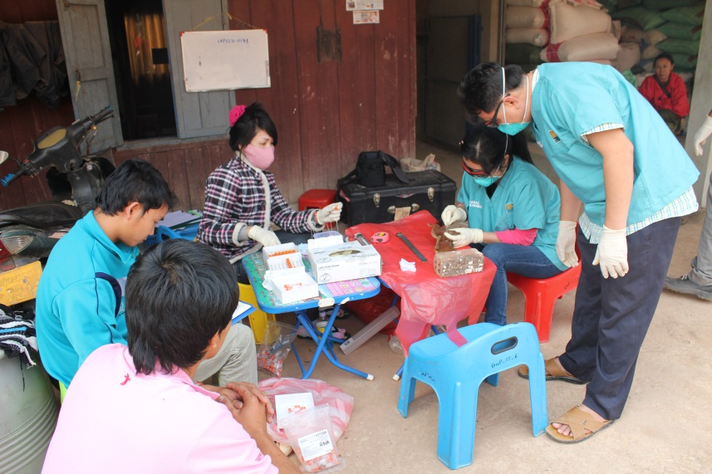
Outline
Overview
Wildlife Trade & Health
Market observation
Arcus work
Lao-Thai WEN

Slide 3
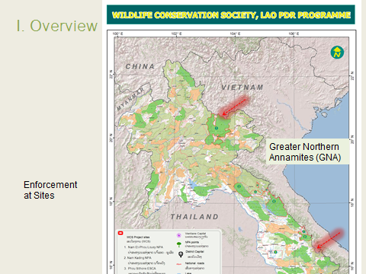

Slide 4
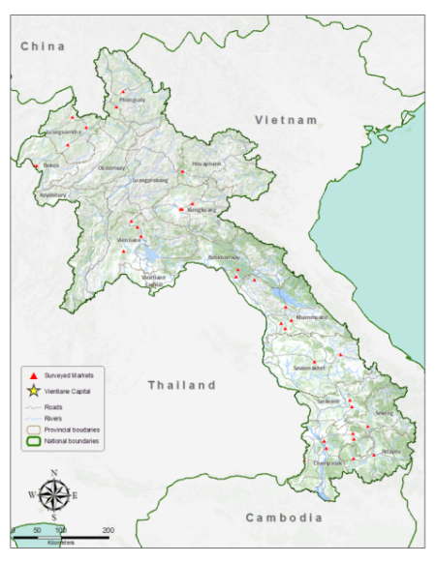
II. Wildlife Health and Trade Observation
Surveys conducted in large 35 markets and 50 small markets in 15 of the 18 provinces in Lao PDR.

Slide 5
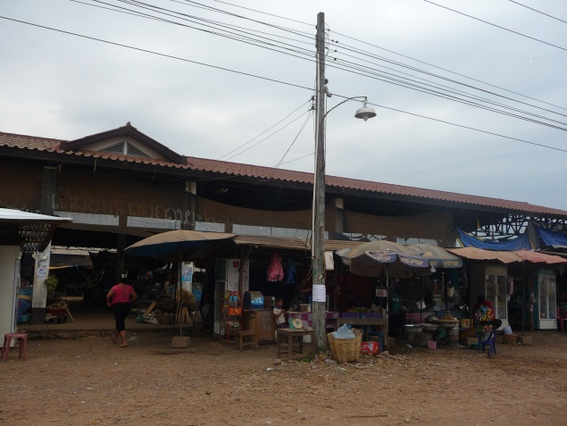
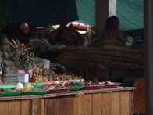
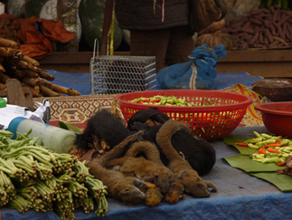
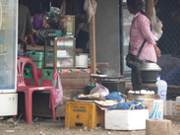
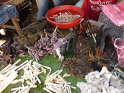
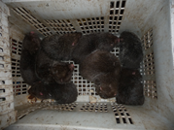
Examples of markets observation (Lak Sao and Tong Namee)

Slide 6
Song Ta Ou Champasak Province
5 observation trips between 2011 and 2013.
4550 animals seen, 2405 reptiles and amphibians, 2091 mammals, 54 birds.

Slide 7
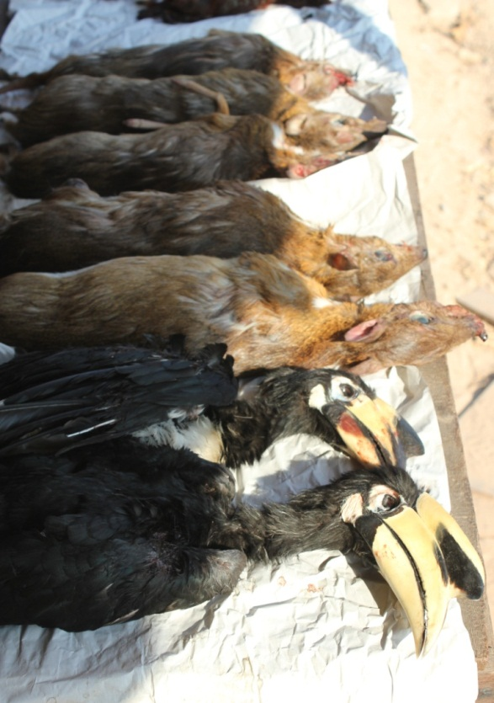
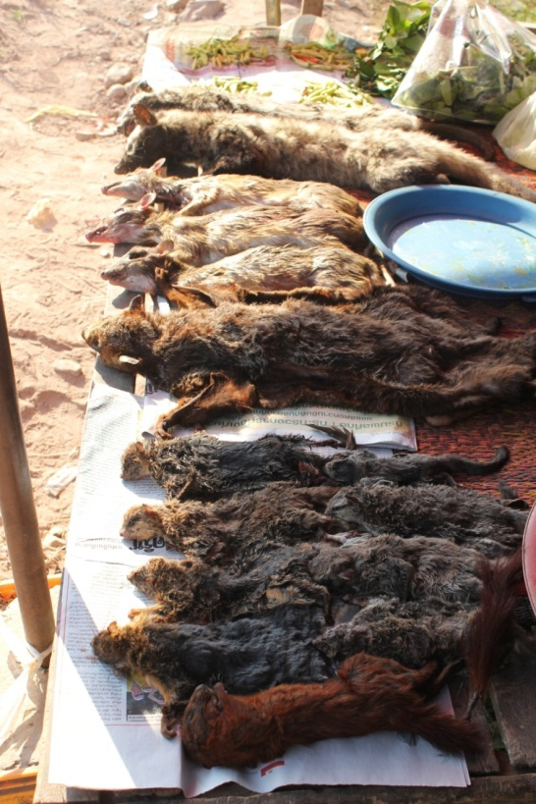
Song Ta Ou Champasak Province

Slide 8
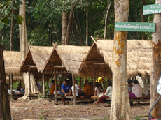
Song Ta Ou Champasak Province
Customers mostly Thai
Restaurants
Take Away
Purchase only

Slide 9
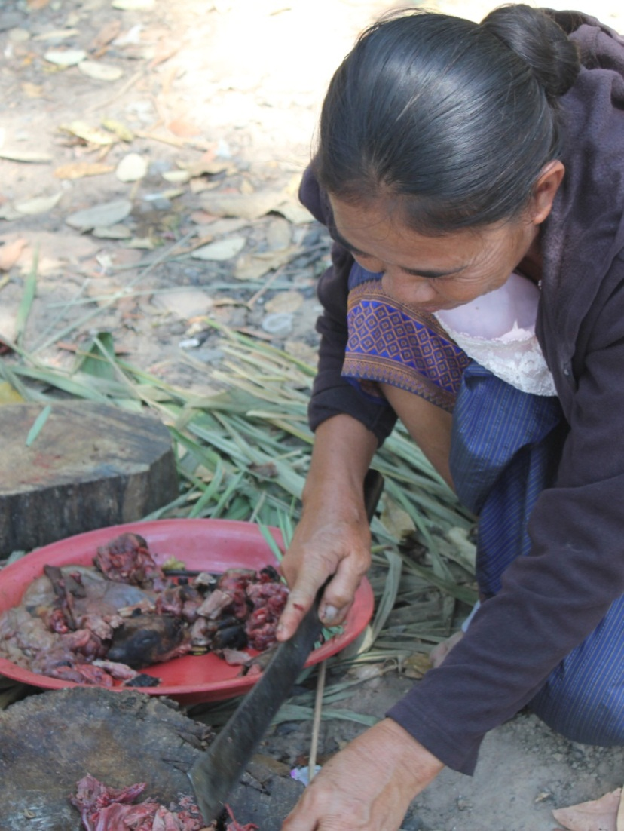
Song Ta Ou Champasak Province

Slide 10
Road side stall

Slide 11
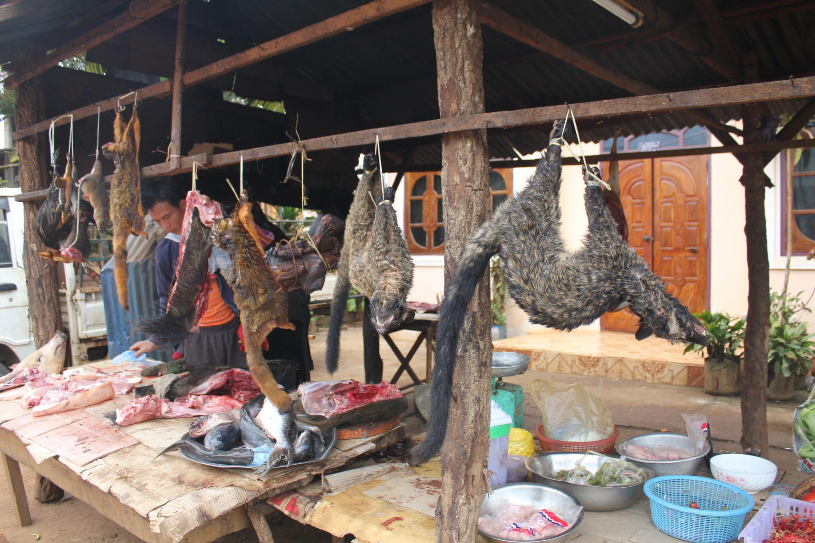
Road side stall

Slide 12
Type of wildlife detected
Data collection on wildlife trade market in Lao PDR during 2010-2013, there are 215 species discovered
Mammal 3 species
Bat 9 species
Carnivore 17 species
Rodent 17 species
Reptile 18 species
Wild bird 138 species
Other 13 species (Serow, Wild pig, Mouse deer, Muntjac, Tree shew, Wild rabbit, Deer, Elephant, Pangolin, Guar, Spotted deer, Sunda flying lemur)

Slide 13
Wildlife Detected, 2010 - 2013
Category | Live | Dead | Total
Other Mammals | 33 | 26 | 59
Carnivores | 32 | 351 | 383
Bats | 162 | 3,411 | 3,573
Rodents | 2,100 | 5,295 | 7,395
Birds | 1,433 | 12,996 | 14,429
Reptiles/Amphibians | 4,336 | 147 | 4,483
Other | 240 | 723 | 963
Total | 8,336 | 22,949 | 31,285
Notes:
disease-related publications per species. Thus, birds=3.33; rodents=6.48; carnivores=35.40; and bats=2.66.
Thus on a per research effort and per species basis, bats have 3.5 times as many known viruses than rodents and more than 25 times more than carnivores.

Slide 15
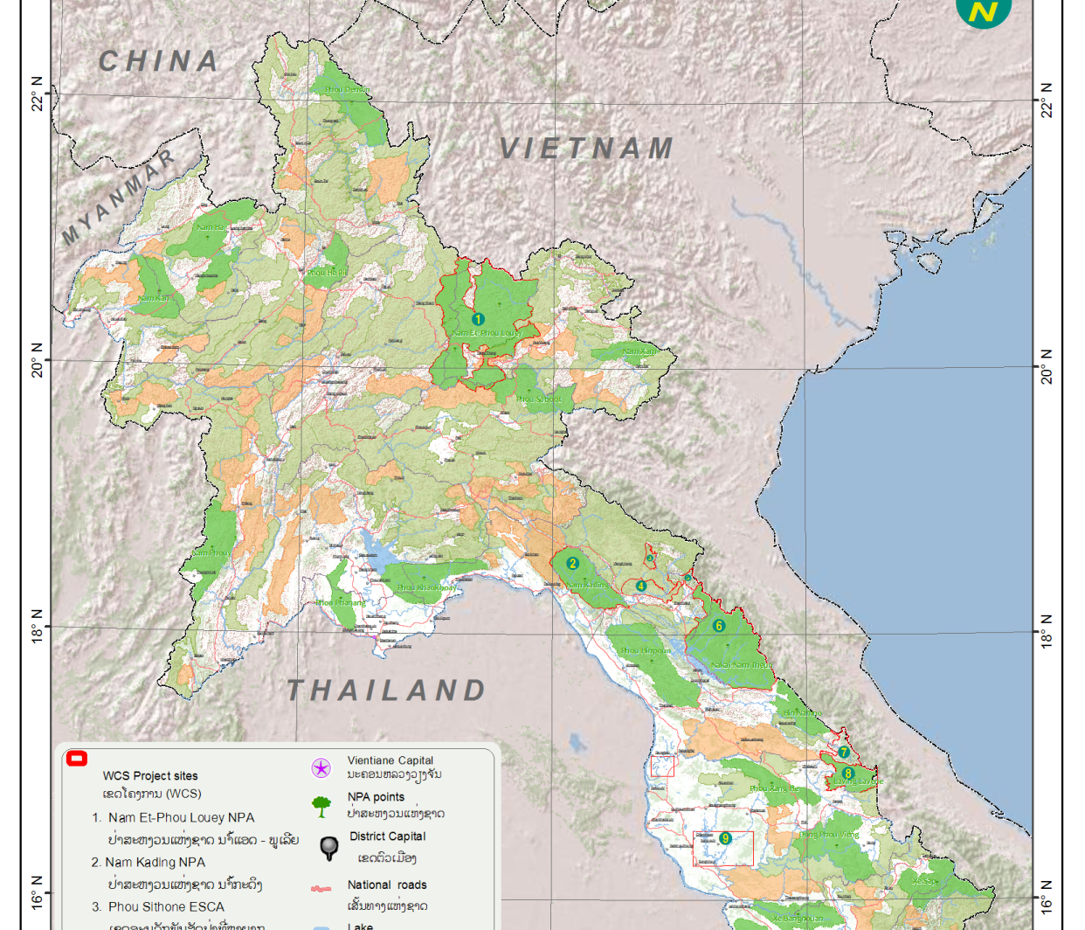
Bolikhamxay Arcus Work - DOFI
2.5 Year Project
MOU with DOFI
Strategic & Tactical Enforcement Patrol Program (STEPP)
Increase the DOFI capacity to decrease illegal wildlife trade (Bushmeat - HVW

Slide 16
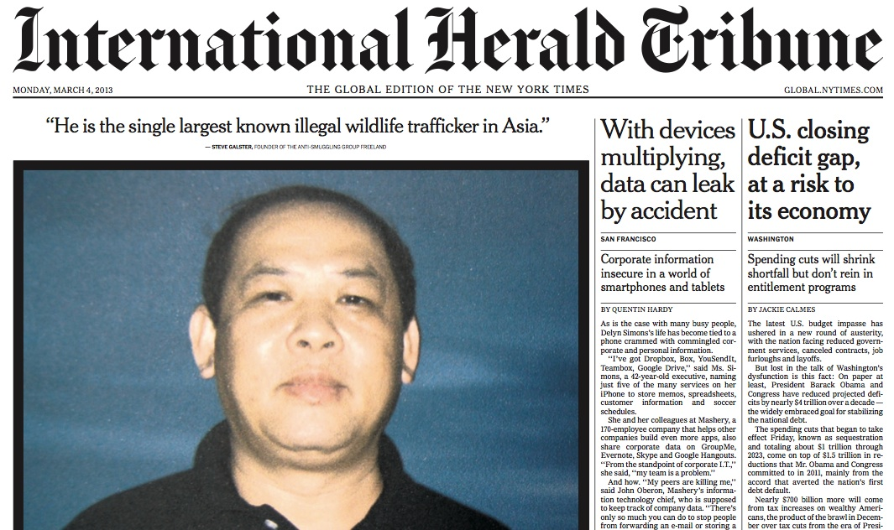

Slide 17
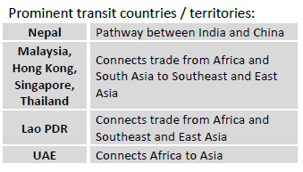

Slide 18
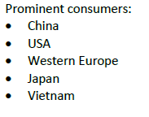

Slide 19
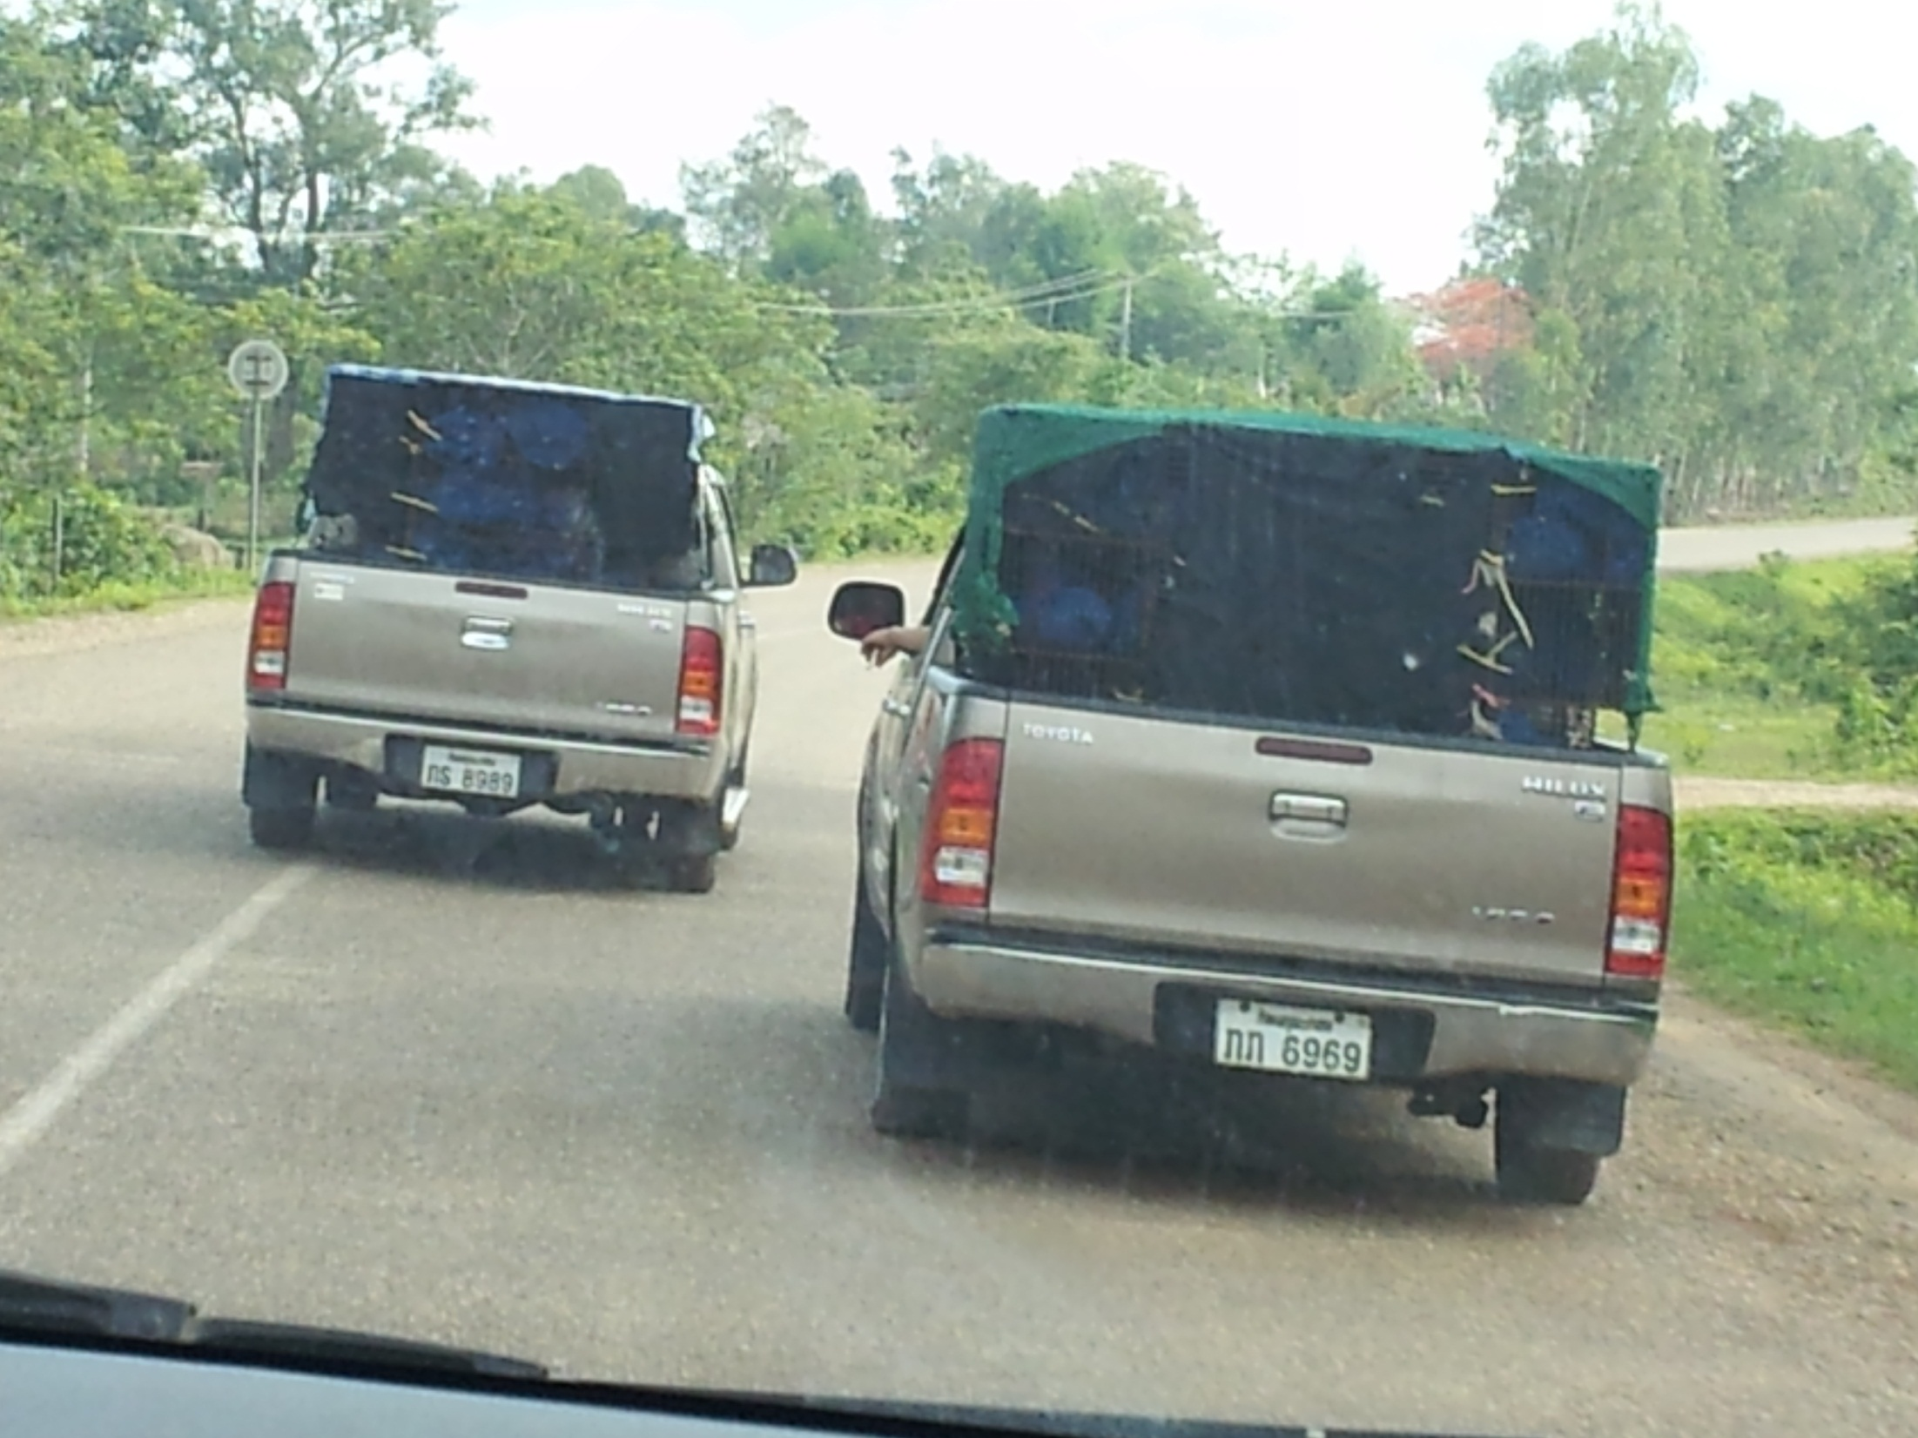
High Valued Wildlife

Slide 20
Bolikhamxay Arcus Work-DoFI
Assisting the GoL
Lao Thai WEN WCS only NGO invited.
US Embassy

Slide 21
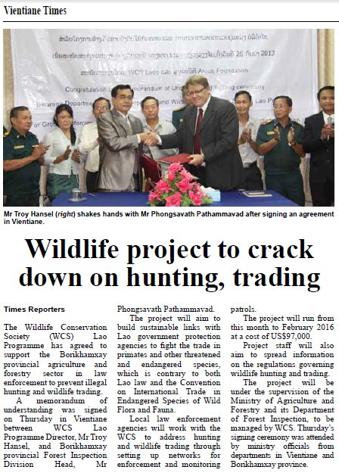

Slide 22
Main activity for Arcus-Bolikhamxay
Improve links between local law enforcement agencies to address hunting and trading wildlife in Bolikhamxay.
Enforcement and monitoring patrols in Bolikhamxay Province
Set up networks for wildlife threat monitoring and law enforcement.
Disseminate information on regulations and enforcement governing hunting and trading wildlife
Notes:
Activities to realize objectives
1. Organize a stakeholder meeting at the central level to discuss the details of the relationships between the different agencies and Wildlife Conservation Society. This will develop the working relationship and platform from support by DOFI. A review of the current STEP will be conducted to see how the wildlife legislation and infractions on-the-ground feature in the current STEP, which is more tailored to timber and logging legislation.
2. Based on the findings in the review and analysis of the threats and causal changes to the threats, an agreement will be drafted between the Wildlife Conservation Society and the Wildlife Division within DOFI detailing how the existing STEP produced will address the issues of hunting and illegal wildlife trade threatening the gibbon and other primate populations.
3. Following the central level discussions, Wildlife Inspection Division of DOFI, PoFI Bolikhamxay and WCS will held the meeting how to implement STEPP which specify in wildlife and aquatic inspection to relevant sectors at Bolikhamxay Province.
4. Development of a provincial Wildlife STEP, jointly created between the POFI and Provincial authority highlights actions to reduce threats to gibbons and other threatened or endangered species.
5. Creation of a patrolling protocol for strategic locations where known wildlife violations occur in Bolikhamxay Province, For example: Market known trading wildlife, on the road side, cross border trade/transit wildlife at Ban Touy and other check points. Conduct regular patrols with the aim of directly reducing threatened and endangered or other key species.
6. DOFI and POFI personnel use IUCN Guidelines for the Placement of Confiscated Animals (2002) for caring and managing live confiscated animals. This protocol will follow the decision tree discussed in the. If applicable and feasible, healthy gibbons may be reintroduced back into the wild following suggested practices as described in the IUCN Best Practice Guidelines for the Re-introduction of Great Apes (2007).
7. To monitor patrolling implementation of project, all data is stored in SMART for analysis ando feed back into the patrolling system to adapt to the rapidly changing of illegal wildlife trade situation .
8. Each quarter, DoFI meets with PoFI to review progress and build further support with higher-level government staff.
9. At the end of year one, the Wildlife Division in DOFI, in conjunction with the provincial POFI will create a lessons learned report and video to highlight the strengths and weaknesses of the project implementation.
10 During the project, the central level DoFI, PoFI will increase collaboration with other agencies such as Lao Customs, Military, Police, the public prosecutor’s office and other Law enforcement agency and collaboration with Vietnam. Joint training, intelligence sharing, and integrated planning with key agencies will be designed
11. At the close of the project, the Wildlife Division of DOFI will seek further collaborations to build in similar activities in other areas with sensitive gibbon populations, while also disseminating lessons learned from these pilot activities.

Slide 23
Laos-Thai WEN SPECIES OF ILLEGAL WILDLIFE TRADE
Animals Pangolins Tiger Reptile (water monitors, cobra, turtles and tortoises) Elephant (wild and domestic) Ivory Rhino horn Wild birds (e.g. red-whiskered bulbul)

Slide 24
Laos-Thailand-Hot Spot routes
Hotspot areas identified for special trade with several routes in and out and also identified as high risk areas for wildlife trafficking:
Thailand | Lao PDR
Border Trade Areas
Nakhon Panom | Kammouane
Nong Khai | Vientiane Capital
Bungkarn | Bolikhamsay
Illegal Trade Areas
That Pha Nom | Ban Pakseabangphai
Tha Uten | Ban Paknam Heanboun
Pengjarn | Ban Thuai
Ponepisai | Ban Hongthong
Pa-krad | Pak Thuai
Ban Peng | Bung kuang
Bungkonglong | Tha sa ah
Bungkha | Pakkading

Slide 25
Thanks you for your patience attention

